Slide 1
Concepts of Operating Systems
Atul Kahate

Slide 2
Session 1: Introduction to Operating Systems

Slide 3

Computer Basics
Processing
Input
Output

Slide 4

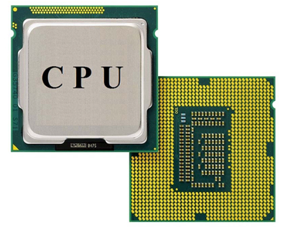
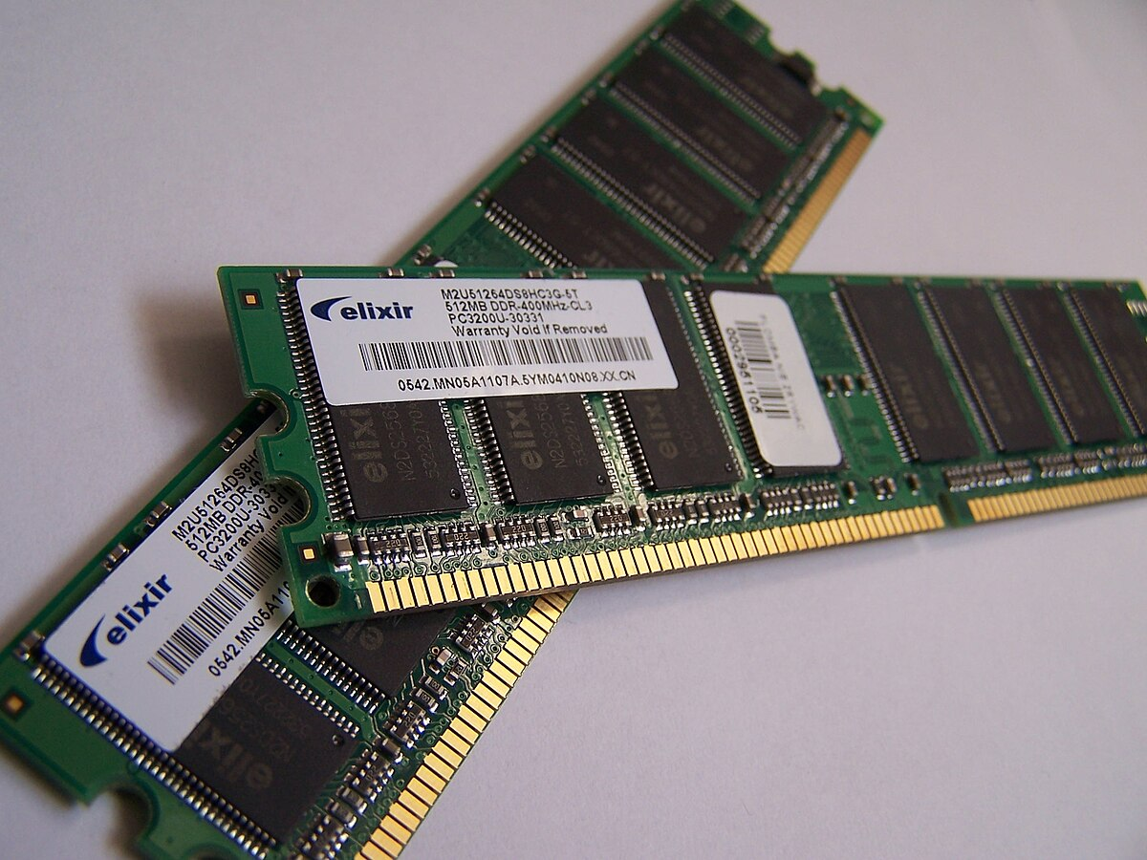
Main Components
Memory subsystem
Input/Output subsystem
Central Processing Unit

Slide 5
Program Execution
Disk
Main memory
CPU
Input
Program code read from the disk
Stored program
Execution
Output

Slide 6
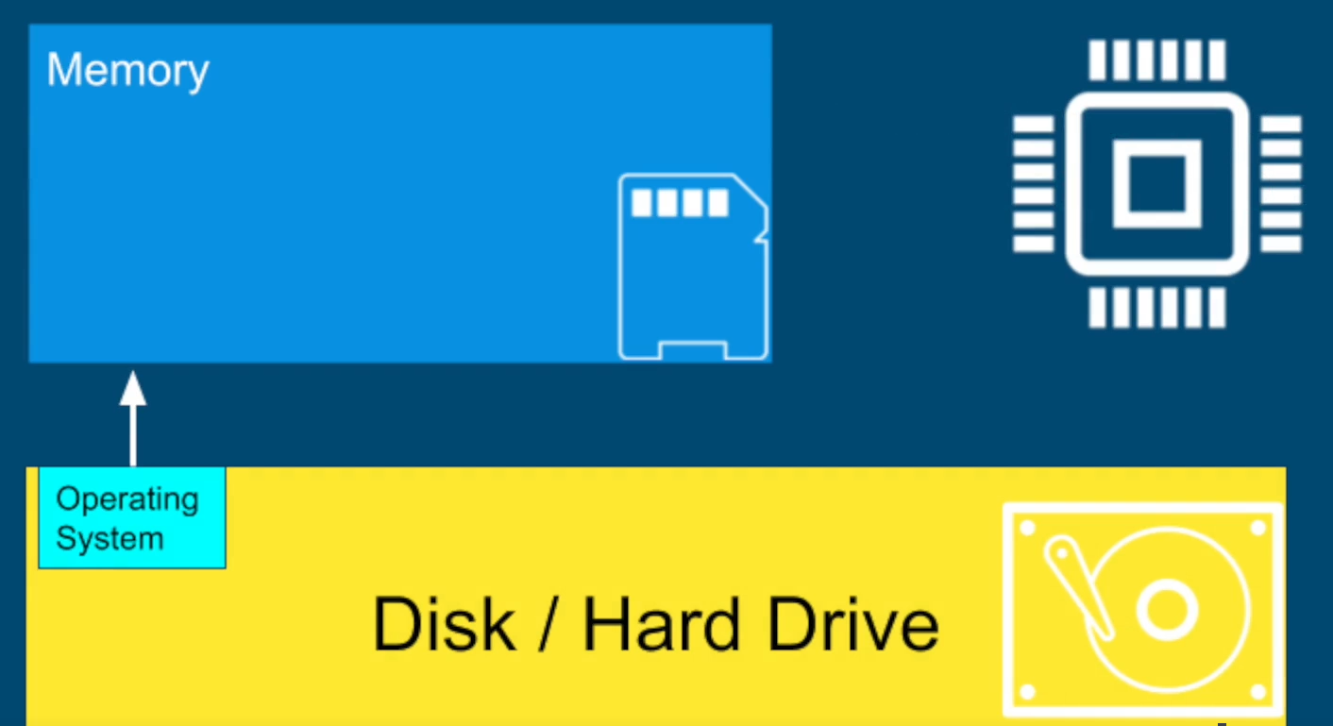
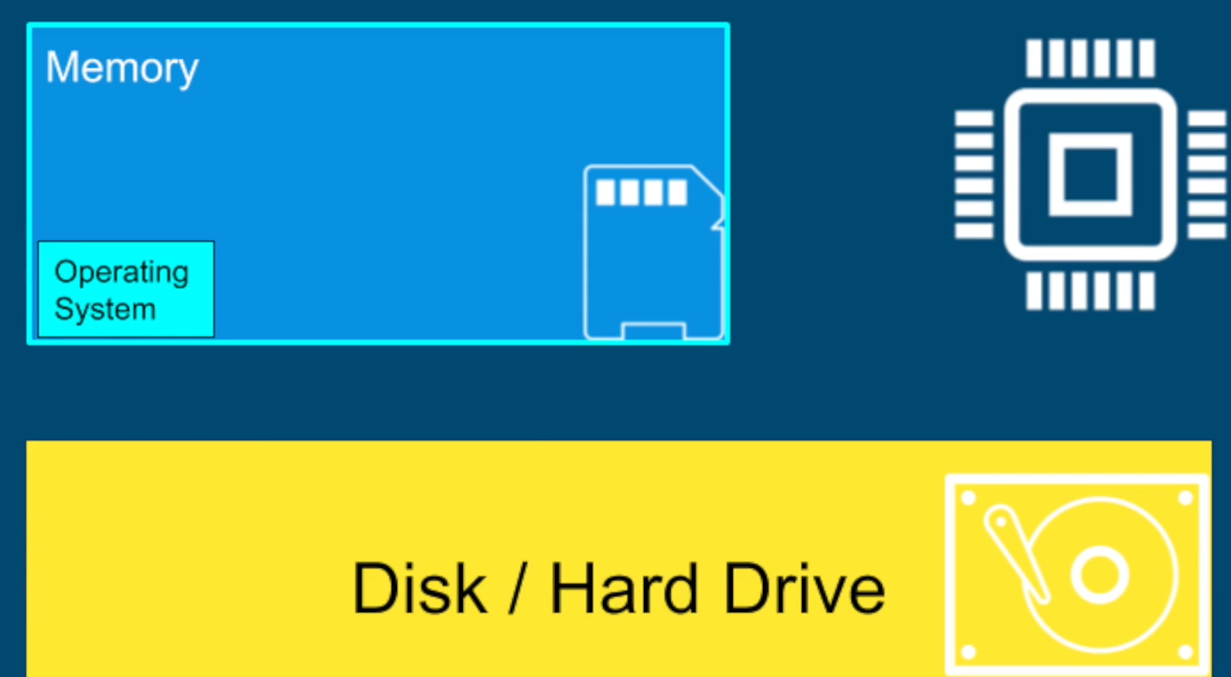
Why Operating Systems?
When we start our computer, a special program called operating system is loaded from the disk into the main memory (RAM) of the computer

Slide 7
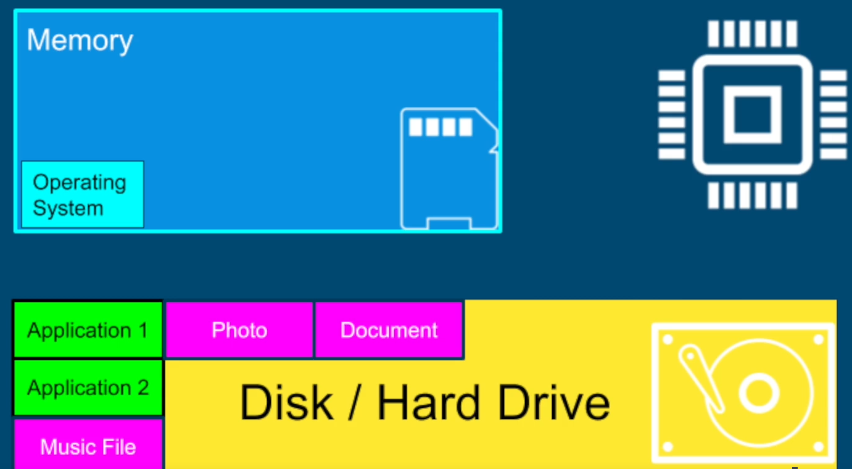
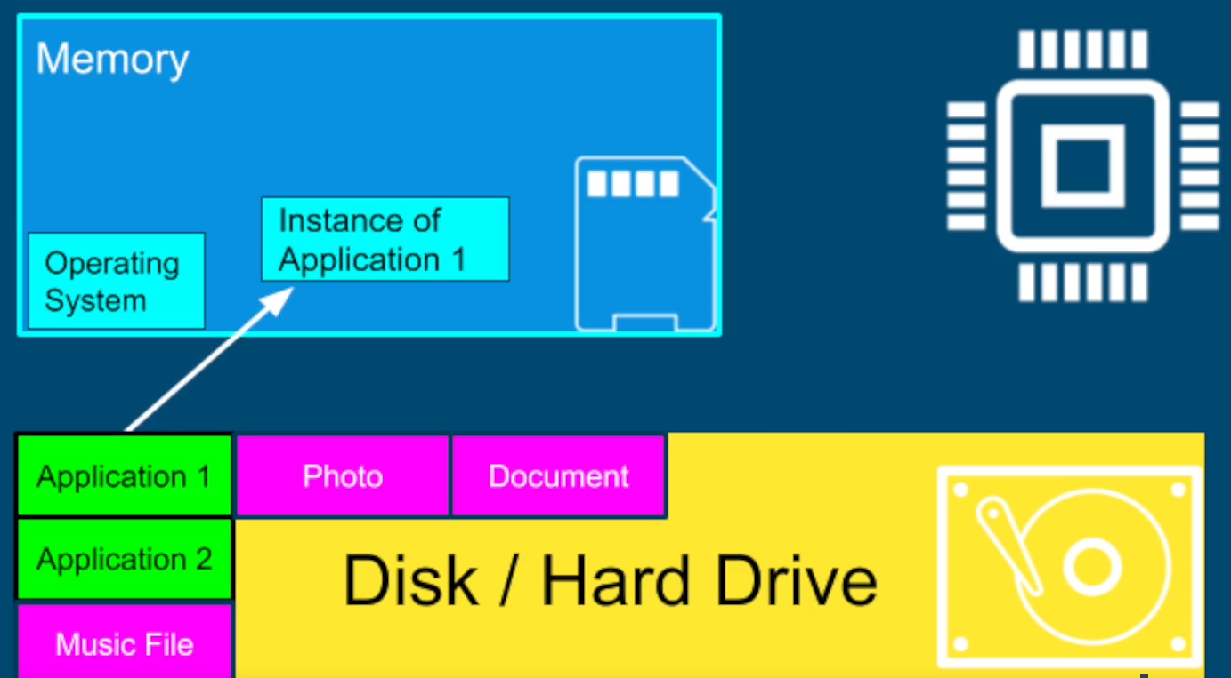
Why Operating Systems?
All our applications are on the disk in the form of files
When we run an application, it is loaded by the operating system into the main memory

Slide 8



Program and Process
Ground
Pavilion

Slide 9
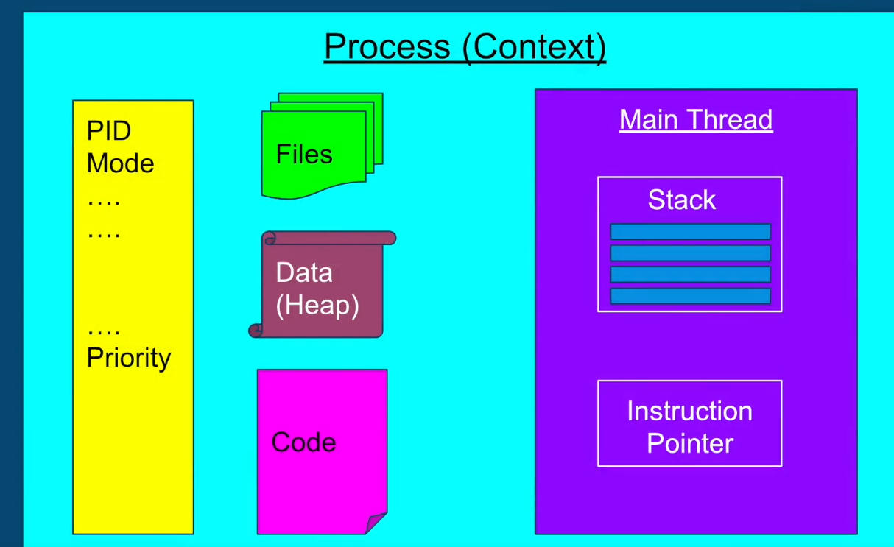
Why Operating Systems?
The instance of a program is a process

Slide 10
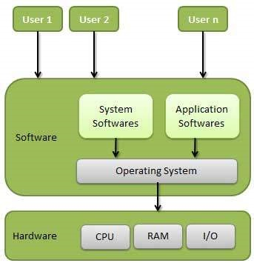
Introduction to OS Concepts
Operating System (OS): A program that acts as an bridge between a user and the computer hardware
Operating system goals:
Execute user programs and make solving user problems easier
Make the computer system convenient to use
Use the computer hardware in an efficient manner

Slide 11
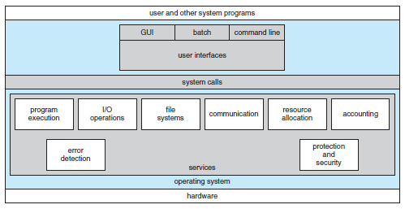
Different Components of an OS

Slide 12
Examples of OS
Mobile OS: Android, iOS
Embedded Systems OS: Embedded Linux, QNX, VxWorks – Generally work on microwave ovens, TV, DVD, MP3 players, etc – Embedded in ROM
Real-time OS: eCos - Deadline-based work, Controlling machines, Welding robots, etc
Desktop OS: Windows, Linux, Mac – General-purpose OS
Server machine OS: Windows server/Linux server – Need to handle client-requests, load, security

Slide 13
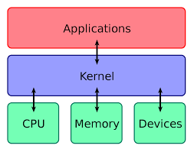
Kernel
“The one program running at all times on the computer” is the kernel
Everything else is either a system program (ships with the operating system) or an application program

Slide 14
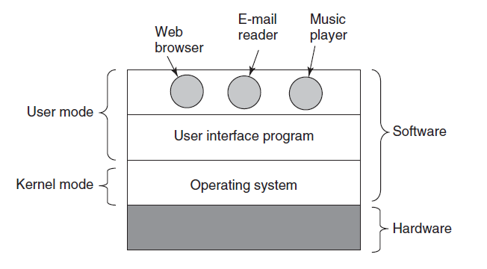
User Mode and Kernel Mode

Slide 15
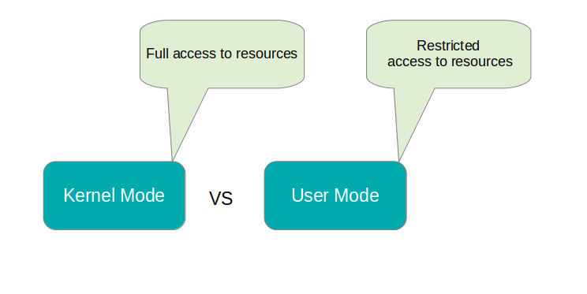
User Mode and Kernel Mode
User mode
Restricted access to resources
If a resource such as disk or file is needed, a signal is sent to the CPU via an interrupt to switch to the kernel mode
Kernel mode (also called as supervisor mode)
Full access to memory, I/O, and other resources

Slide 16
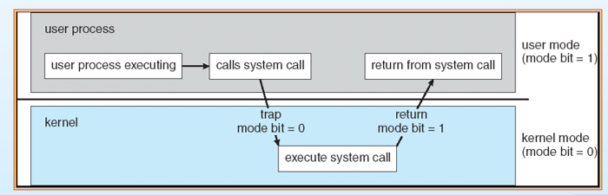
User Mode to Kernel Mode Transition
When the process is executing in the user mode, its user mode bit = 1
When it executes a system call to enter kernel mode, its user mode bit = 0
At the end of the system call, when the process returns to the user mode, its user mode bit = 1

Slide 17
Interrupt
Situation: A process in the user mode needs to execute some instruction in the kernel mode
Action: It needs to switch from user mode to kernel mode
How to do?: It generates an interrupt and makes a system call

Slide 18
Session 2: Introduction to Linux

Slide 19
Linux History
Linux: World’s most widely used operating system
Origins in UNIX: Ken Thompson – 1969
Too many UNIX versions
Richard Stallman created GNU (1984): Free software alternative to UNIX, created UNIX utilities, but kernel was missing
Led to 0pen source movement
Free software: Response to licensed/proprietary software
Free = Free in spirit, not zero price
Richard Stallman: Users should have freedom to run, copy, distribute, study, change, and improve the software
Linux kernel: Created by Linus Torvalds in 1991

Slide 20
True UNIX versus UNIX-like
UNIX: A trademark of The Open Group
Maintains a single UNIX standard
Companies that develop UNIX-based OS can pay them to get as True UNIX certified
Example: Mac is True UNIX
Other UNIX-based OS that are not certified by The Open Group are called UNIX-like

Slide 21
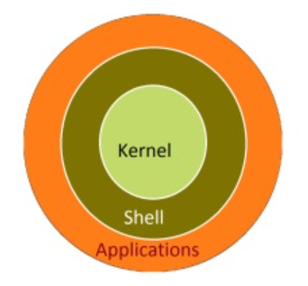

Linux Kernel
Kernel: Main component of the operating system
Manages memory, process scheduling, hardware, etc

Slide 22
Installing Linux – Multiple Options
On a Windows machine, install WSL (Simplest and light-weight)
https://learn.microsoft.com/en-us/windows/wsl/install
Use a virtual machine and install a Linux distribution
VMWare or Oracle VirtualBox (See https://techbland.com/how-to-install-lubuntu-on-virtualbox-on-windows/)
Create a dual-boot machine (Windows and Linux)

Slide 23
Virtual Machine Concept
Hardware
Windows (Host/Base OS)
Virtual Machine Manager (VirtualBox/VMWare)
VM-1 (Linux)
VM-2 (Windows)
VM-3 (Linux)

Slide 24

Linux Distributions (“Distros”)

Slide 25
Linux Command Line
Command line = Shell
Shell | Program Name | Description
Bourne shell | sh | Original shell program from AT&T, available on all UNIX systems
C shell | csh | Shell developed as a part of BSD UNIX
TC shell | tsh | Similar to csh, with some enhancements
Korn shell | ksh | AT&T’s improvement of the Bourne shell
Bourne Again Shell | bash | Shell distributed with Linux

Slide 26
Shell
User interface to an operating system
Exposes OS services to users or other programs
Takes our commands and gives them to the OS for execution
Shell – because like an Oyster shell, it is the strong outer layer around the OS
A terminal program allows us to access the shell

Slide 27
Opening the Terminal
Option 1: Start button -> System tools -> Terminal
Option 2: Start button and search for terminal
Option 3: In any directory, Tools -> Open Terminal
Option 4: Ctrl + Alt + T

Slide 28

The Shell Prompt
General format: username@machinename, followed by the current working directory, and a dollar sign
If we have a hash (#) at the end, instead of the dollar, the user has superuser/root privileges

Slide 29
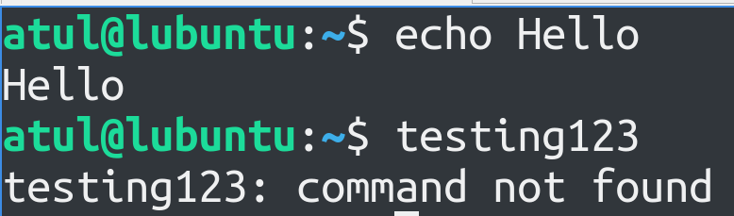
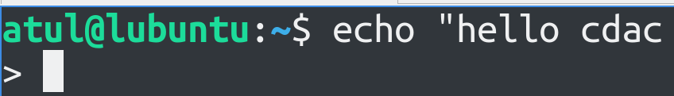
Valid and Invalid Commands
Valid commands: Valid output, Invalid commands: Error
Sometimes, we expect the command prompt to appear, but it does not
Example: Type “hello cdac and press ENTER
It thinks the command is not complete
Use either “ or Ctrl+C to complete/exit

Slide 30
The date Command
date: Display the system date
TZ='America/Los_Angeles' date: As per the specified time zone
Question: Display the system date in following format: Today is Friday, 17 May 96
date +"Today is %A, %d %B %y"
%A: Full weekday name (e.g., Monday, Tuesday)
%d: Day of the month (01 to 31)
%B: Full month name (e.g., January, February)
%y: Year without century (00 to 99)

Slide 31
Linux Command Format
command -option argument
Command: The name of the command we want to execute
Options: Change the default command behavior and start with a single hyphen or double hyphen, i.e. – or --
Single hyphen: Short form of the option, Double hyphen: Full option name
Arguments: Inputs to the command
Examples:
date -I … ISO format
date --iso … Same command, but using full form of the option
date -r /path/to/file … Last modification date and time for a file

Slide 32
Command Options: More Examples
sort -ru colors.txt
sort -r -u colors.txt
sort --reverse --unique colors.txt
All the above commands will give the same result

Slide 33
The Manual Page
Documentation/Help about commands/Linux in general
The man command
Example: man sort
Type q to exit

Slide 34
The which Command
Returns the executable file name for a command
Example: which clear

Slide 35
File and Directory Management

Slide 36
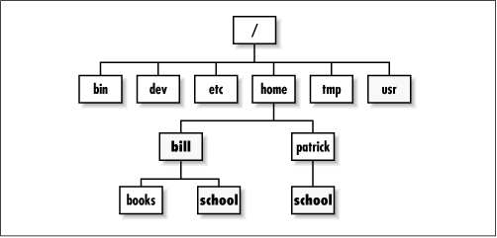
Directory Structure
/ is the root directory – Starting point for the file system
Each user on the system has a sub-directory inside home
The tilda symbol (~) represents the user’s home directory

Slide 37
Confusion!
Try this:
cd /
ls
This means go to the root directory and see directory listing
We see a directory named root! What is this?
Linux creates a default user called root (the superuser/administrator), who has its home directory named root under the actual top-level root directory, i.e. /

Slide 38
The home directory
The /home directory contains a sub-directory for each user on the system
Example: /home/dac, /home/dbda, /home/ditiss, /home/ai
The user dac’s home directory will be /home/dac, etc

Slide 39
Directory Shortcuts
/ Root directory (the very beginning of the file system)
~ Current user’s home directory (e.g. /home/dac)
. Current directory
.. Parent of the current directory

Slide 40
File and Directory Commands
touch: Create an empty file
pwd: Print Working Directory
cd: Change directory
Absolute path: Start from root – cd /home/atul/Downloads
Relative path: Start from current position – cd .. or cd test
Go to root: cd /
Go to user’s home directory: cd
Note: . is the current directory and .. Is the parent directory
ls: List all files in a specified directory
mkdir: Create a directory
cp: Copy files and directories
mv: Rename a file/directory
rm: Delete a file, rm -r: Recursively delete a directory and all sub-directories

Slide 41
Linux Editors
vi – The original Linux editor
vim – Improved version of vi
nano – Easy to work with (To install: sudo apt-get update and then sudo apt-get install nano)

Slide 42
The vi Editor
Modal editing: Three different modes: normal, insert, command-line
Normal mode: Navigate the file, Editing commands are possible
Insert mode: For inserting text
Command-line mode: Editor commands
Normal mode commands: Cursor movement using h (left), j (down), k (up), l (right), w (one word forward), b (one word back), gg (BOF), G (EOF)

Slide 43
Using vi
Problem: Create a file test.txt, add three lines, save and exit and again reopen the file and edit the second line, save and exit.
By default, vi starts in the normal mode, so press i to switch to insert mode and type three lines, then ESC, then type :wq and ENTER to save and exit
Then reopen the file, use j twice to move cursor down two lines, press i to switch to insert mode, again repeat ESC :wq ENTER
To quit vi without saving the changes, ESC :q! ENTER
To display line numbers in vi, ESC :set number ENTER

Slide 44
Moving First Three Lines of a File to its End in vi
Once inside vi, press the Esc key to ensure you are in command mode.
Move the cursor to the beginning of the file by pressing gg.
Enter visual mode by typing V (uppercase V).
Move the cursor down to select the first three lines by pressing 3j or simply 3↓.
Once the lines are selected, cut them by typing d.
Move to the end of the file by typing G.
Paste the cut lines by typing p.

Slide 45
Copy the 5th line and paste it above the first line in vi
Once inside vi, press the Esc key to ensure you are in command mode.
Move the cursor to the 5th line by typing 5G or simply 5gg.
Enter visual mode by typing V (uppercase V).
Move the cursor down to select the entire 5th line by pressing j or ↓.
Once the line is selected, copy it by typing y.
Move to the first line by typing gg.
Paste the copied line above the first line by typing P (uppercase P).

Slide 46
Find and Replace in vi
Forward search cdac: ESC and then /cdac (n to go to the next occurrence, N to go to the previous occurrence)
Backward search cdac: ESC and then ?cdac (n to go to the previous occurrence, N to go to the next occurrence)
Replace abc with xyz: ESC and then :%s/abc/xyz/g
Note: g = global, if omitted, it will replace only the first occurrence

Slide 47
Counting Number of Lines in a File, etc
The word count (wc) command
Find out number of lines, words, bytes and characters in a file
Create two files: state.txt and capital.txt
Andhra Pradesh
Arunachal Pradesh
Assam
Bihar
Chhattisgarh
Amaravati
Itanagar
Dispur
Patna
Raipur

Slide 48
Counting Number of Lines in a File, etc
Andhra Pradesh
Arunachal Pradesh
Assam
Bihar
Chhattisgarh
wc state.txt
5 7 58 state.txt
wc state.txt capital.txt
5 7 58 state.txt
5 5 39 capital.txt
10 12 97 total
wc -l state.txt
5 state.txt
wc -w state.txt capital.txt
7 state.txt
5 capital.txt
12 total
Number of lines
Amaravati
Itanagar
Dispur
Patna
Raipur
Number of words

Slide 49
Counting Number of Lines in a File, etc
wc -c state.txt
58 state.txt
ls | wc -l
17
Andhra Pradesh
Arunachal Pradesh
Assam
Bihar
Chhattisgarh
Number of bytes
Number of files and directories in the current directory
Amaravati
Itanagar
Dispur
Patna
Raipur

Slide 50
File inode and links
inode (index node): A data structure that stores metadata about a file or directory
File type (Regular, Directory, Link), Permissions, Owner and Group, Size, Timestamps, Pointers to data blocks, Link count
Link: Association between a file name and its inode
Hard link: Directory entry (File name->inode), If multiple, then multiple directory entries -> One file, Changes made through one -> Reflect everywhere
Soft link or Symbolic link (symlink): A special type of file that contains a reference to another file, Does not point to inode but to the path of the file

Slide 51
Example
Create a file using echo: echo "This is some text." > FILE2
Create two more hard links to the file:
ln FILE2 FILE2_hardlink1
ln FILE2 FILE2_hardlink2
Now, we have three hard links to the same file: FILE2, FILE2_hardlink1, and FILE2_hardlink2
Check the inode number and link count for each of these names:
ls -i -l FILE2 FILE2_hardlink1 FILE2_hardlink2

Slide 52
Examples
Question | Command | Key points
List all the files and sub directories of the directory /bin. | ls -la /bin | -l = Long listing, -a = All files, including hidden files
List all the files including hidden files in your current directory. | ls -la
List all the files starting with letter ‘r’ in your current directory. | ls r*
List all the files having three characters in their names, from your current directory. | ls ??? | ? wildcard = Exactly one character
List all the files with extension .doc in your current directory. | ls *.doc
List all the files having the first letter of their name within the range ‘l’ to ‘s’, from your current directory. | ls [l-s]* | * = Any number of any characters
Create a file text1 and read its input from keyboard. | echo "Type your input here:" > text1 cat >> text1 | Press ENTER and Ctrl+D to terminate. The >> redirection operator directs the output of a command to the end of a file

Slide 53
Examples
Question | Command | Key points
Copy the contents of file text1 to another file text2. | cp text1 text2
Append the contents of file text2 to file text1. | cat text2 >> text1
Count the number of files in the current directory. | ls -l | grep "^-" | wc -l | grep "^-": Filters out only the lines that represent regular files (not directories or other types of files). In the long format, the lines representing regular files start with -. wc -l: Counts the number of lines.
Display the output of command ls –l to a file and on the output screen. | ls -l | tee ls_output.txt | tee command reads from standard input and writes to standard output and files simultaneously.
From file text1 print all lines starting from 10th line. | tail -n +10 text1 | tail = Display EOF, -n: How many lines?, +10: Start from the 10th line (If we use 10, it will be the last 10 lines)

Slide 54
Examples
Question | Command | Key points
Find the number of users currently logged on to the system. | who who | wc -l | wc -l will give number of users, since it will count the lines of the output of the who command
Delete all the files with their names starting with “tmp”. | rm tmp*

Slide 55
The who Command
Display all users: who
Possible question: Combine the outputs of the who and pwd commands:
who && pwd
The && operator chains multiple commands, second runs only if the first one succeeds

Slide 56
su and sudo Commands
Linux is very strict about what users can do
Ordinary users can work in their home directory and can perform operations related to their own work
Many Linux operations require elevated (higher) privileges: Two commands can be used for this
sudo: Superuser Do: Execute a command as the superuser – Own password is needed
Example: Update system package list: sudo apt update … apt = Advanced Package Tool
su: Switch User: Switch the current user to another user (If no name is specified, switch to root) – Target user’s password is required
Example: su - to switch to the root user and then exit to return to the previous user

Slide 57
Users
Create a new user: sudo adduser cdac
Delete a user: sudo deluser cdac

Slide 58
File Ownership
Every file created on Linux is owned by some user
We can find the owner/user name when we run the ls -l command
After the user name, we see the group name
Why is group name = user name?
When we create a user, Linux automatically also creates a group by the same name and makes the user a part of that group
But then, what is a group?

Slide 59
Group
Group = Collection of users
Helps manage access to files, directories, other system resources
Example:
Alice and Bob are a part of DAC group
Carol and Dave are a part of AI group
Alice and Carol are a part of GuestLectures group
Carol and Dave are a part of CampusCommittee group
Alice, Bob, and Dave are a part of ExtraCurricular group
Every user has a primary group and possibly secondary groups
User’s primary group is mentioned in /etc/passwd file

Slide 60
Group
Each group has a group ID (GID), internally maintained by Linux
Find existing groups: groups
Create/modify/remove groups: groupadd, groupmod, groupdel commands
sudo groupadd marketing Create a new group
sudo groupmod -n sales marketing Rename marketing to sales
sudo groupdel sales Remove the group
Membership management
sudo usermod -aG marketing john Add a user john to marketing group
sudo gpasswd -d marketing john Remove user john from the group (May not work due to permissions issue)
Find groups and their members: cat /etc/group | sort
Find group names of a user: groups <username>, e.g. groups dac

Slide 61
File Attributes
Type | Owner permissions |  |  | Group permissions |  |  | Other users permissions
- d l | r | w | x | r | w | x | r | w | x
Run ls -l command
10 characters at the beginning are called file attributes
Character 1: d = directory, - = file, l = Symbolic link
Next 3 characters: Owner permissions
Next 3 characters: Group permissions
Next 3 characters: Others permissions

Slide 62
Creating a Symbolic link
Suppose we have a file named hello.txt
To create a symbolic link: ln -s hello.txt symbolic_link_example
Verify: ls -l
Now you can say nano symbolic_link
To remove the symbolic link: rm symbolic_link

Slide 63
File Permissions
For whom
u Owner/user
g Owner group
o Other users
a All/Everyone
Operations
+ Add permission
- Remove permission
= Reset everything else
Permissions
r Read
w Write
x Execute

Slide 64
chmod Command: Character-based
chmod u+x file1: Add execute permission to user
chmod g-w file1: Remove write permission from group
chmod u+x,g+r test.txt: Add execute permission to user, read permission to group
chmod a=r file1: Remove all existing permissions and only allow read to all

Slide 65
Octal File Permissions
Read | Write | Execute | Permission | Meaning | Binary | Decimal
0 | 0 | 0 | - - - | No permission | 000 | 0
0 | 0 | 1 | - - x | Execute only | 001 | 1
0 | 1 | 0 | - w - | Write only | 010 | 2
0 | 1 | 1 | - w x | Write and Execute | 011 | 3
1 | 0 | 0 | r - - | Read only | 100 | 4
1 | 0 | 1 | r - x | Read and Execute | 101 | 5
1 | 1 | 0 | r w - | Read and Write | 110 | 6
1 | 1 | 1 | r w x | Read, Write, and Execute | 111 | 7

Slide 66
chmod command: Octal
chmod 700 file1: All the permissions only for the owner, no permissions for anyone else
chmod 777 file1: All the permissions for everyone
chmod 755 file1: rwx for user, rx and group, rx for others
chmod 525 file1: rx for owner, w to group, rx for others
chmod 621 file1: rw for owner, w to group, x for others

Slide 67
The Global Regular Expression Print (grep) Command
Search for specific patterns (regular expressions) in text
grep CDAC hello.txt Search for the word CDAC in hello.txt file
ls | grep ct List files whose name contains ct anywhere
ls | grep ^Pi List files whose name starts with Pi
ls | grep es$ List files whose name ends with es

Slide 68
A sample file: TheGreatGatsby
grep "Gatsby" GreatGatsby.txt
head "GreatGatsby.txt"
grep "if" GreatGatsby.txt -i ... ignore case
grep "ate" GreatGatsby.txt
grep "ate" GreatGatsby.txt -w ... whole words only
grep “Gatsby" GreatGatsby.txt -ic ... Count and ignore case
grep “Gatsby" GreatGatsby.txt -n ... Display line number along with the match

Slide 69
Recursive Search using grep
Go to the user’s home directory: cd ~
Now search for the word cdac in all the directories and sub-directories inside this path: grep cdac -r

Slide 70
Regular Expressions with grep
Anchors
^: Start of a line
$: End of a line
grep "^gatsby" "GreatGatsby.txt" –i
grep "out$" testfile.txt

Slide 71
Regular Expressions with grep
Character classes
[abc]: Matches any single character a, b, or c
[a-z]: Matches any single character from a to z
[0-9]: Matches any single digit
grep "[abc]" GreatGatsby.txt
grep "[p-r]" GreatGatsby.txt
grep "[1-5]" GreatGatsby.txt

Slide 72
Past Exam Question
Count the number of lines in file “cdac-sylabus.txt” which has word “JAVA” in that line.
Note: The word should not have any prefix or suffix. Eg “EBJAVA” or “JAVAB” should be excluded while getting the counts for “JAVA”

Slide 73
find Command
Search for files and directories
Find a file based on its name: find -name one.txt
Find all files with extension .txt: find -type f -name "*.txt“
Find a file with a specific name recursively in all sub-directories starting with the current directory: find . -type f -name one.txt
Find all files with size > 10kb: find -type f -size +10k
Same, but also see the actual size > 10kb: find -type f -size +10k –ls
Find directories with permission 755: find -type d -perm 755 -ls

Slide 74
Additional Commands With the find Command
find -name "*.txt" -exec cat {} \;
Find all the files with extension and display their contents one by one
-exec cat {} \; runs like a loop for each .txt file, {} getting replaced with the file name and finally \; indicating the end of exec

Slide 75
Problems: find Command
Problem | Command
Files with extension .c or .pl | find . -type f \( -name "*.c" -o -name "*.pl" \)
Directories having permission 755 | find . -type d -perm 755
Files having permission 655 | find . -type f -perm 655
Files having inode number 12122 | find . -type f -inum 12122
Files which have not been accessed for more than a year and save the list in Old_File | find . -type f -atime +365 -print > Old_File
Files whose size is greater than 1024 bytes | find . -type f -size +1024c

Slide 76
Linux Processes
List all processes: ps
If we run the command again, we will again see the same two processes, but the PID for ps process would be different
To get help about all the options: ps --help all
Now try ps -e
The ps command shows processes for the current user only, but ps -e or ps -A shows all the processes running on the computer
top command: Shows dynamic list of processes and the resources they are consuming

Slide 77
Killing a Process
Reduce the terminal size of top command to half and open a second terminal in the second half
Note the pid of the top process
In the other terminal, try kill <pid>
This sends a SIGTERM to top process, killing it

Slide 78
Piping and Redirecting
Pipe (|) symbol: Connects the output of one command to the input of the next command, so command->command
Example: ls | grep .txt … First get a list of files in the current directory and then only filter those file names whose extension is .txt
Greater than (>) symbol : Redirects the output of a command to a file, so command->file
Example: ls > filelist.txt … Store the output of the ls command in a file called filelist.txt

Slide 79
Wildcards
Wildcards help us create patterns for searching in shell commands
They are used to match text or string data
There are three main wildcard characters: * ? []

Slide 80
Wildcards
Character | Use | Example
Star or asterisk (*) | Search for specific characters 0 or more times | ls a* will search for all files in the current directory whose names start with a
Question mark (?) | Search for fixed number of characters, where one ? Represents one character | ls ???t.txt will search for all files in the current directory whose names are 4 characters long, end with t, and have an extension of txt
Square brackets ([]) | Match characters based on a range or in a group | ls hello.[t-z]* will search for all files in the current directory whose name is hello and extension is any number of any characters between t and z

Slide 81
Wildcard Examples
ls a* - List all files whose names start with a, file extension may or may not be there
ls a*.pqr - List all files whose names start with a, but file extension should be pqr
ls *.txt – Files that have extension txt
ls *.sh *.txt - Files that have extension txt or sh
ls Great*by.txt - Files whose name starts with Great, ends with by, and have extension txt
ls ?i* - Files whose names have i as the second character
ls *.??? – Files with any name, but exactly three characters in the extension
ls [sv]* - Files whose names begin with s or v
ls [s-v]* - Files whose names begin with any letter between s and v
ls *[0-9]* - Files whose names include at least one digit
ls [afgh]*o* - Files whose names start with a letter between and h and followed anywhere by letter o

Slide 82
Character Classes
We can use character classes to check for substrings or to do other comparisons
They are an alternative to the earlier wildcard syntax
Examples:
‘[:alpha:]’ instead of ‘[A-Za-z]’
‘[:lower:]’ instead of ‘[a-z]’
‘[:upper:]’ instead of ‘[A-Z]’
‘[:alphanum:]’ instead of ‘[0-9A-Za-z]’
‘[:digit:]’ instead of ‘[0-9]’
Note: If we are using these in bash commands, we need two square brackets – See next slide

Slide 83
Using Character Classes in Shell Commands
ls [:upper:]*.* - Will match any files that contain characters u p p e r in the file name – NOT WHAT WE WANT
We should write it as: ls [[:upper:]]*.*
Now we will get files whose names contain at least one upper case character

Slide 84
Regular Expressions
Wildcards and character codes can be used in regular expressions
Regular expressions allow us to check sub-strings, do exact string comparisons, etc
We will discuss this during Shell programming

Slide 85
Shell Scripts

Slide 86
Variables
User-defined variables
INSTITUTE=“ACTS”
echo “Hello $INSTITUTE”
Shell variables
echo "Home directory: $HOME"
echo "Username: $USER"
echo "Current directory: $PWD"
echo "Process ID: $$“
Display the following text message on the monitor screen.
Deposited $100 to you account: echo "Deposited \$100 to your account"
We need to use \ as escape character here

Slide 87
What is a Shell Script?
Shell script: A file containing a series of commands
Examples of commands:
echo “5/2” | bc
echo “scale=2; 5/2” | bc
echo “scale=10; 5/2” | bc
name=“Linux Student”
echo $name > out.txt

Slide 88
Writing a Shell Script – Pseudocode
Open a new file with an extension .sh and write your pseudocode
Example: Display the logged in user’s user id and also display if it is the root user or not
nano get_user_name.sh
# Get the user id
# Check if user id is root or not

Slide 89

Writing a Shell Script – Shebang Operator
‘Shebang’ or ‘Shabang’ operator:
# means sharp (as in C#)
! In comics is used as Bang!
#!/bin/bash
# Get the user id
# Check if user id is root or not

Slide 90
Writing a Shell Script – Get the User Id
#!/bin/bash
# Get the user id
CURRENT_USER_NAME=$USER
echo “Logged in user is: $CURRENT_USER_NAME”
# Check if user id is root or not

Slide 91
Executing a Shell Script
Try running: get_user_name.sh
Error!
Specify the path using dot
Try running: ./get_user_name.sh
Error!
Give execute permission to yourself
chmod u+x get_user_name.sh
Try running: ./get_user_name.sh

Slide 92
Complete the Shell Script, Save and Rerun
#!/bin/bash
# Get the user id
CURRENT_USER_NAME=$USER
echo “Logged in user is: $CURRENT_USER_NAME”
# Check if user id is root or not
if [ "$UID" -eq 0 ]; then
echo "$current_user is the root user."
else
echo "$current_user is NOT the root user."
fi

Slide 93
Using Variables
read_example_prompt.sh
#!/bin/bash
read -p "Enter your name: " name
read -p "Enter your age: " age
read -p "Enter your city: " city
echo "My name is: $name"
echo "My age is: $age"
echo "My city is: $city"

Slide 94
Conditions – if Statement
#!/bin/sh
a=10
b=20
if [ $a -eq $b ]
then
echo “a is equal to b”
fi
if [ $a -ne $b ]
then
echo “a is not equal to b”
fi

Slide 95
Same Example using if-else
#!/bin/sh
a=10
b=20
if [ $a -eq $b ]
then
echo “a is equal to b”
else
echo “a is not equal to b”
fi

Slide 96
Check If a Number is Even or Odd
#!/bin/bash
read -p "Enter a number : " n
rem=$(( $n % 2 ))
# Other syntaxes
# let "rem = n % 2"
# rem=$(expr $n % 2)
# rem=$(echo "$n % 2" | bc)
if [ $rem -eq 0 ]
then
echo "$n is even number"
else
echo "$n is odd number"
fi

Slide 97
if-elif-else
#!/bin/bash
echo "Enter a Number"
read num
if [ $num -lt 0 ]
then
echo "Negative"
elif [ $num -gt 0 ]
then
echo "Positive"
else
echo "Neither Positive Nor Negative"
fi

Slide 98
Max of three numbers
#!/bin/bash
echo "Enter Num1"
read num1
echo "Enter Num2"
read num2
echo "Enter Num3"
read num3
# To accept multiple inputs: read num1 num2 num3
if [ $num1 -gt $num2 ] && [ $num1 -gt $num3 ]
then
echo $num1
elif [ $num2 -gt $num1 ] && [ $num2 -gt $num3 ]
then
echo $num2
else
echo $num3
fi

Slide 99
String Comparison
#!/bin/bash
# Shell script to check whether two
# input strings is equal
# take user input
echo "Enter string a : "
read a
echo "Enter string b : "
read b
# check equality of input
if [ "$a" == "$b" ]; then
# if equal print equal
echo "Strings are equal."
else
# if not equal
echo "Strings are not equal."
fi

Slide 100
Calculate Average using Bash Calculator
#!/bin/bash
read -p "Enter marks in subject 1: " marks1
read -p "Enter marks in subject 2: " marks2
read -p "Enter marks in subject 3: " marks3
total=$(( $marks1 + $marks2 + $marks3 ))
echo "Total marks: $total"
avg=$( echo "scale=4; $total / 3" | bc )
echo "Average marks: $avg"

Slide 101
Input Must Have All Alphabets
=~ is an operator in Bash to compare a string with a regular expression pattern
^ indicates start of the string
+ indicates one or more characters
$ indicates end of the string
#!/bin/bash
read -p "Enter a string: " input_string
if [[ $input_string =~ ^[[:alpha:]]+$ ]]; then
echo "Input contains only alphabetic characters."
else
echo "Input contains non-alphabetic characters."
fi

Slide 102
Accept Only a 10-Digit Phone Number
#!/bin/bash
read -p "Enter a 10-digit number: " input
# Check if the input consists of exactly 10 digits using regex
if [[ $input =~ ^[0-9]{10}$ ]]; then
echo "Valid input: $input"
else
echo "Invalid input. Please enter a 10-digit number."
fi

Slide 103
Shell Program Containing Many File Operations
#!/bin/bash
# Create a directory if it doesn't exist
if [ ! -d "my_directory" ]; then
mkdir my_directory
echo "Directory 'my_directory' created."
fi
# Move into the directory
cd my_directory
# Create a new file
echo "Hello, world!" > my_file.txt
echo "Contents written to 'my_file.txt'."
# Display file content
echo "Contents of 'my_file.txt':"
cat my_file.txt
# Append to the file
echo "Appending more text." >> my_file.txt
echo "Additional content appended."
# Display file content again
echo "Contents of 'my_file.txt' after appending:"
cat my_file.txt
# Copy the file
cp my_file.txt my_file_copy.txt
echo "'my_file.txt' copied to 'my_file_copy.txt'."
# Rename the file
mv my_file_copy.txt my_new_file.txt
echo "'my_file_copy.txt' renamed to 'my_new_file.txt'."
# Check if a file exists
if [ -e "my_new_file.txt" ]; then
echo "'my_new_file.txt' exists."
fi
# Delete the original file
rm my_file.txt
echo "'my_file.txt' deleted."
# List files in the directory
echo "Files in the directory:"
ls
# Move out of the directory
cd ..
# Remove the directory and its contents
rm -r my_directory
echo "Directory 'my_directory' and its contents removed."

Slide 104
C-Style for Loop
#!/bin/bash
# testing the C-style for loop – double brackets are needed
for (( i=1; i <= 10; i++ ))
do
echo "The next number is $i"
done

Slide 105
while Command
#!/bin/bash
# while command test
var1=10
while [ $var1 -gt 0 ]
do
echo $var1
var1=$[ $var1 - 1 ]
done

Slide 106
break Example
#!/bin/bash
# breaking out of a for loop
for var1 in 1 2 3 4 5 6 7 8 9 10
do
if [ $var1 -eq 5 ]
then
break
fi
echo "Iteration number: $var1"
done
echo "The for loop is completed"

Slide 107
PS Variables
Prompt Statement Environment Variables
PS1: Default interaction prompt
PS2: Continuation interaction prompt
PS3: Prompt used by the select statement inside a script

Slide 108
PS1: Default Interaction Prompt
Try this command: export PS1="\u@\h \w> “
The default prompt will be changed to show the user name, home, and working directory
export PS1="\u\w:\d-\t>"
PS1="\$(date +%d.%m.%Y) > "
export PS1
PS1="\D{%F %T}>“
export PS1="\u@\h [\$(date +%k:%M:%S)]> "

Slide 109
PS2
For incomplete commands, shell will display a secondary prompt as > and wait to complete the command and hit Enter again
Example:
echo “this is a
> test”
PS2=“continue …”
echo “this is a
continue... test”

Slide 110
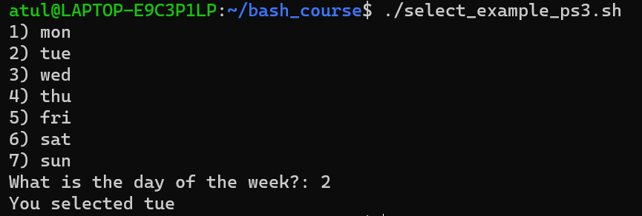
The select Command and the PS3 (Prompt for Select command) Variable
select_example_ps3.sh
#!/bin/bash
PS3="What is the day of the week?: "
select day in mon tue wed thu fri sat sun;
do
echo "You selected $day"
break
done

Slide 111
Problems and Solutions
1. List only the directories in your current directory
ls -d */ | wc -l
2. Display the name and count of the directories in the current directory.
ls -d */ | wc -l
3. Find out whether the users with a pattern“itp9” in their names have logged in ?
who | grep 'itp9'
4. Find out whether a particular user “itp9” has logged in ?
who | grep -w 'itp9'
5. Assign a value “Black” to var1 and then display the following message on the terminal using this variable: Black belt is associated with karate
var1="Black"
echo "${var1} belt is associated with karate"

Slide 112
Problems and Solutions
Create the file employee.txt having colon (: ) separated fields. The fields of the record are: enumber, ename, eposition, esal, edoj, edept. And now answer the following:
List all the employees along with a row number
Sort the file as per the names
List top three salaried employees
Remove duplicate records from the file
List dept. no along with no. of employees working in each dept.
Sort the file in descending order of salary
a. nl employee.txt
b. sort -t':' -k2 employee.txt
c. sort -t':' -k4nr employee.txt | head -n 3
d. sort -u -t':' -k1,1 employee.txt
e. while IFS=':' read -r _ _ _ _ _ edept; do
echo "$edept"
done < employee.txt | sort | uniq -c
f. sort -t':' -k4nr employee.txt

Slide 113
Problems and Solutions
Accept a file name and a number (x). Display x lines from the top of the file.
Check if the file exists and is readable. The value of x should not exceed the total number of lines in the files. Display suitable messages in case an error is encountered.

Slide 114
Problems and Solutions
#!/bin/bash
# Function to display usage message
usage() {
echo "Usage: $0 <file_name> <number_of_lines>"
}
# Check if correct number of arguments are provided
if [ "$#" -ne 2 ]; then
usage
exit 1
fi
# Assign command line arguments to variables
file_name="$1"
number_of_lines="$2"
# Check if file exists and is readable
if [ ! -r "$file_name" ]; then
echo "Error: File '$file_name' does not exist or is not readable."
exit 1
fi
# Check if number of lines is not greater than total lines in the file
total_lines=$(wc -l < "$file_name")
if [ "$number_of_lines" -gt "$total_lines" ]; then
echo "Error: Number of lines provided exceeds total lines in the file ('$total_lines')."
exit 1
fi
# Display x lines from the top of the file
head -n "$number_of_lines" "$file_name"

Slide 115
Problems and Solutions
Write a menu based script which displays the following options :
Accept roll number, name, marks in sub1, sub2 and sub3. Calculate total, percentage, grade & class and enter the record in a file “student”. The marks are out of 100 in each subject. Allow the user to enter any number of records.
Grade is found out as follows :
Percentage Grade
< 35 Fail
>= 35 & < 50 Third
>= 50 & < 60 Second
>= 60 & < 75 First
>= 75 Distn
If the student secures < 35 in any one of the subjects, then class = “fail”. Otherwise
class=”pass”.

Slide 116
Problems and Solutions
#!/bin/bash
# Function to calculate grade based on percentage
calculate_grade() {
if (( $1 < 35 )); then
grade="Fail"
elif (( $1 >= 35 && $1 < 50 )); then
grade="Third"
elif (( $1 >= 50 && $1 < 60 )); then
grade="Second"
elif (( $1 >= 60 && $1 < 75 )); then
grade="First"
else
grade="Distn"
fi
}
# Function to calculate class
calculate_class() {
if (( $1 < 35 || $2 < 35 || $3 < 35 )); then
class="Fail"
else
class="Pass"
fi
}
# Function to display menu
display_menu() {
echo "Menu:"
echo "1. Enter Student Record"
echo "2. Display Student Records"
echo "3. Exit"
}
# Function to enter student record
enter_record() {
echo "Enter Roll Number:"
read roll_number
echo "Enter Name:"
read name
echo "Enter Marks in Subject 1:"
read sub1
echo "Enter Marks in Subject 2:"
read sub2
echo "Enter Marks in Subject 3:"
read sub3
# Calculate total marks and percentage
total=$((sub1 + sub2 + sub3))
percentage=$((total / 3))
# Calculate grade and class
calculate_grade $percentage
calculate_class $sub1 $sub2 $sub3
# Write record to file
echo "$roll_number $name $sub1 $sub2 $sub3 $total $percentage $grade $class" >> student
echo "Record added successfully."
}
# Function to display student records
display_records() {
echo "Roll Number | Name | Sub1 | Sub2 | Sub3 | Total | Percentage | Grade | Class"
echo "---------------------------------------------------------------------------"
cat student
}
# Main script
while true; do
display_menu
read -p "Enter your choice: " choice
case $choice in
1) enter_record ;;
2) display_records ;;
3) echo "Exiting program."; exit ;;
*) echo "Invalid choice. Please enter a valid option." ;;
esac
done

Slide 117
Problems and Solutions
Accept roll number from the user at the command line. Search it in the “student” file. If it is present, then display name, percentage, grade and class of the student. If the roll number is not present, then display a message “not found”. Allow the user to enter any number of queries.

Slide 118
Problems and Solutions
#!/bin/bash
# Function to search for roll number in student file
search_roll_number() {
roll_number="$1"
found=false
while read -r line; do
rno=$(echo "$line" | cut -d ' ' -f 1)
if [[ "$rno" == "$roll_number" ]]; then
found=true
name=$(echo "$line" | cut -d ' ' -f 2)
percentage=$(echo "$line" | cut -d ' ' -f 7)
grade=$(echo "$line" | cut -d ' ' -f 8)
class=$(echo "$line" | cut -d ' ' -f 9)
echo "Roll Number: $roll_number"
echo "Name: $name"
echo "Percentage: $percentage"
echo "Grade: $grade"
echo "Class: $class"
break
fi
done < student
if [ "$found" == "false" ]; then
echo "Roll number $roll_number not found."
fi
}
# Check if a roll number was provided as argument
if [ "$#" -ne 1 ]; then
echo "Usage: $0 <roll_number>"
exit 1
fi
# Call search function with provided roll number
search_roll_number "$1"

Slide 119
Past Lab Exam Question
Write a bash script to take input string from user. Print output as follows.
a) If all the characters in input string is upper case, print “Input String is in UPPER case”
b) If all the characters in input string is lower case, print “Input String is in LOWER case”
c) else print “Input String is in MIXED case”

Slide 120
Past Lab Exam Question
Note: Some shells allow the = operator to be used for string comparison instead of ==, but it is not recommended.
We should use = for assignment and == for comparison.
Example:
my_variable="Hello"
and
if [ "$string1" == "$string2" ]; then
echo "Strings are equal.“
fi
#!/bin/bash
echo "Please enter a string: "
read input
# Check if the input is all uppercase
if [[ $input == [A-Z]* ]]; then
echo "The input is in all uppercase."
# Check if the input is all lowercase
elif [[ $input == [a-z]* ]]; then
echo "The input is in all lowercase."
# If it's not all uppercase or all lowercase, it must be mixed case
else
echo "The input is in mixed case."
fi

Slide 121
Past Lab Exam Question
Write a bash script to take input Number as upper limit from user.
a) Print the PID of the current script
b) Print the Numbers in reverse till we reach zero
e.g: If the user enters 5, print the numbers as below in separate lines
5
4
3
2
1
c) Input Number range is greater than 1 and less than 100
d) If user inputs number less than 1 or more than 100 print message “Input Number is Out of range”

Slide 122
Past Lab Exam Question
$$ is a special shell variable that represents the PID of the current running script
#!/bin/bash
echo "Enter the upper limit:"
read num
if [ $num -lt 1 ] || [ $num -gt 100 ]
then
echo "Input Number is Out of range"
else
echo "PID of the current script: $$"
for (( i=$num; i>=1; i-- ))
do
echo $i
done
fi

Slide 123
Past Lab Exam Question
Write a bash script to take two input string from user. Print the output as follows
a) If the input string 1 and input String 2 matches, Print “The TWO STRING matches”. The match should not be case sensitive. Means Input String 1 is “SPARK” and input 2 string is “Spark”, still it should print “The TWO STRING matches”.
b) If the input string 1 and input String 2 does not match, Print “The TWO STRING DOES NOT match”

Slide 124
Past Lab Exam Question
#!/bin/bash
echo "Enter the first string:"
read str1
echo "Enter the second string:"
read str2
if [ "${str1,,}" == "${str2,,}" ]
then
echo "The TWO STRINGS MATCH"
else
echo "The TWO STRINGS DO NOT MATCH"
fi
"${str1,,}": converts the string to lowercase
==: checks if two strings are equal
"${input^^}“: converts the string to uppercase

Slide 125
Past Lab Exam Question: Another Solution for the Same Problem
#!/bin/bash
echo "Enter the first string:"
read string1
echo "Enter the second string:"
read string2
# Convert both strings to lowercase and compare
lowercase_string1=$(echo "$string1" | tr '[:upper:]' '[:lower:]')
lowercase_string2=$(echo "$string2" | tr '[:upper:]' '[:lower:]')
if [ "$lowercase_string1" == "$lowercase_string2" ]; then
echo "The strings are equal (case-insensitive)."
else
echo "The strings are not equal (case-insensitive)."
fi

Slide 126
sed
Stream editor, as opposed to a normal interactive editor
It is a text editor without an interface. You can use it from the command line to manipulate text in files and streams.
With sed you can do all of the following:
Select text
Substitute text
Add lines to text
Delete lines from text
Modify (or preserve) an original file

Slide 127
sed Example
echo "This is a test" | sed 's/test/big test/’
The echo command sends “This is a test” into sed using pipe symbol
The simple substitution rule (s = substitute) is applied
sed searches the input text for an occurrence of the first string (test) and replaces with the second (big test)
Output will be sent to the terminal window

Slide 128
sed Examples
Note: File contents are not changed, only output is changed.
Create python.txt
Python is a very popular language.
Python is easy to use. Python is easy to learn.
Python is a cross-platform language
sed '2 s/Python/perl/g' python.txt → Replacement in the second line, g means all the instances in that line (here, 2)
sed 's/Python/perl/g2' python.txt → Replace the second occurrence on every line, wherever there is a match
sed '1 s/Python/perl/' python.txt → Replace the first occurrence on the first line
sed '$s/Python/Bash/' python.txt → Replace the last line’s first occurrence

Slide 129
sed and Delete
Create os.txt
Windows
Linux
Android
OS
sed '/OS/d' os.txt → Delete lines containing the word OS
sed '/Linux/,+2d' os.txt → Delete line containing the word Linux and next two lines

Slide 130
sed and Insert
Create myfile
This is a test and I like this test.
This is the next line of the test script.
sed '2i\This is the inserted line.' myfile → Insert a new second line
sed '2a\This is the appended line.' myfile → Append a new line (Note the position of the new line)
i is before and a is after

Slide 131
View a Range of Lines
Create sedtest.txt
This is a demo text file.
It is an amazing file that will help us all.
The sed command is also great for stream editing.
Want to learn how to use the command?
This is another line in the file.
This is the third general line in the file.
This file is named as textfile.
This is a apple.
This is a orange.
sed -n '3,5p' sedtest.txt => Display lines between 3 and 5
sed '3,5p' sedtest.txt => Display lines between 3 and 5
sed ‘3,5d' sedtest.txt => Display lines other than between 3 and 5
The -n flag prevents sed from displaying the pattern space at the end of each cycle.
The p argument stands for print and is used to display the matched lines to the user.
The d flag deletes the matched strings from the output and displays the rest of the content.

Slide 132
sed | More Examples
sed -n -e '1,2p' -e '5,6p' sedtest.txt => Display non-consecutive lines
The -e flag helps in executing multiple actions using a single command.
sed s/originalword/replaceword/g filename => Replace something
sed s/amazing/super/g sedtest.txt
The s argument denotes substitution and the g command is used to replace the matched content with the specified replacement content.

Slide 133
sed | More Examples
sed '2,5s/This/That/g’ sedtest.txt => Substitute words in a range of lines (2 to 5 in this example)
sed 's/amazing/super/g;s/command/utility/gi' textfile.txt => Multiple substitutions
sed -e '/orange/ s/a/an/g’ sedtest.txt
Replace the word a with an if the word orange is present in the line

Slide 134
Adding Users
sudo: Superuser Do: Execute a command as the superuser – Own password is needed
su: Switch User: Switch the current user to another user (If no name is specified, switch to root) – Target user’s password is required
The useradd and adduser command
Example: sudo useradd cdac
To allow the new user to login, we must set a password for the new user
Example: sudo passwd cdac
On some Linux distributions, the new user’s home directory is not automatically created, in which case, we need to use the following syntax
sudo useradd -m cdac
On Ubuntu, we can use a different command: sudo adduser cdac and to give the user admin privileges, sudo usermod -aG sudo cdac

Slide 135
Removing Users
The userdel and deluser command
Example: sudo deluser cdac
On Ubuntu, we can use a different command: sudo userdel cdac

Slide 136
Changing File Ownership
The chown command
Change the user and/or group ownership of a given file or directory
Example: sudo chown cdac test.txt
Verify by using the ls -l command

Slide 137
Past Lab Exam Questions
Convert all file names from upper case to lower case
for i in $( ls | grep [A-Z] ); do mv -i $i `echo $i | tr 'A-Z' 'a-z'`; done
Convert all file names from upper case to lower case and change .txt extension to .pdf
for i in $( ls | grep [A-Z] ); do mv -i $i `echo $i | tr 'A-Z' 'a-z'`; done | find . -depth -name "*.txt" -exec sh -c 'f="{}"; mv -- "$f" "${f%.txt}.pdf“’ \;
Alternative: Bash script – See next slide

Slide 138
Another solution
#!/bin/bash
echo "Enter the folder path:"
read folder_path
for file in "$folder_path"/*.txt; do
if [[ -f "$file" ]]; then
filename=$(basename -- "$file")
extension="${filename##*.}"
filename="${filename%.*}"
new_filename="${filename^^}.UPC"
mv -- "$file" "$folder_path/$new_filename"
fi
done

Slide 139
Past Lab Exam Question
What are the command to perform below tasks:
a) Rename a file from “application.jsp” to “application.html”
b) Find a process running with PID “2391”
c) Print the first 15 lines from file “content.txt”
d) Find files with name “java.cpp” within current folder or its subfolders
e) Create group as “tester”

Slide 140
Past Lab Exam Question
mv application.jsp application.html
ps -p 2391
head -n 15 content.txt
find . -name "java.cpp"
sudo groupadd tester

Slide 141
FTP, Telnet, etc

Slide 142
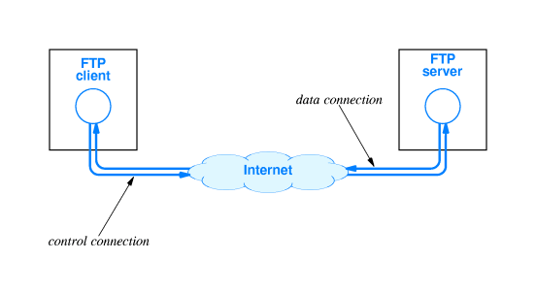
FTP Concept

Slide 143
FTP (File Transfer Protocol)
One of the earliest Internet protocols for file transfers
Allows downloading (server-to-client) or uploading (client-to-server) of files remotely
Made up of two parts
FTP server: Has files that can be downloaded, or it can also receive files from the users
FTP client: Downloads the require files from an FTP server, or it can upload files to the FTP server also

Slide 144
Setting up FTP Server on Ubuntu (on VirtualBox)
Step 1: A common open-source FTP utility used in Ubuntu is vsftpd.
sudo apt install vsftpd
Step 2: Start the FTP server
sudo systemctl start vsftpd
Step 3: Backup configuration files for safety
sudo cp /etc/vsftpd.conf /etc/vsftpd.conf_default

Slide 145
Setting up FTP Server on Ubuntu
Step 4: Create an FTP user, so that a client can access the FTP server
sudo useradd -m testuser
sudo passwd testuser
Step 5: Allow FTP through the firewall
sudo ufw allow 20/tcp
sudo ufw allow 21/tcp
Step 6: Connect to the FTP server locally
sudo ftp Ubuntu
(Here, Ubuntu is considered to be our Linux machine name, so replace it with the actual machine name)

Slide 146
Accessing the FTP Server from our Windows Machine
Open command prompt and type ftp
ftp> open
To 192.168.0.24 … This is the IP address of the Ubuntu machine – to find it, we can type ip a or ifconfig on the Ubuntu machine’s terminal
Connected to 192.168.0.24.
220 (vsFTPd 3.0.5)
200 Always in UTF8 mode.
User (192.168.0.24:(none)): testuser
331 Please specify the password.
Password:
230 Login successful.

Slide 147
Accessing the FTP Server from our Windows Machine
ftp> stat
Connected to 192.168.0.24.
Type: ascii; Verbose: On ; Bell: Off ; Prompting: On ; Globbing: On
Debugging: Off ; Hash mark printing: Off .
ftp> pwd
257 "/home/testuser" is the current directory
ftp> dir

Slide 148
Checking for Files
Create a file on the FTP server (i.e. Ubuntu machine)
atul@atul-virtualbox:~$ sudo su
root@atul-virtualbox:/home/atul# cd /home/testuser/
root@atul-virtualbox:/home/testuser# nano test.txt

Slide 149
Now Check in Windows FTP Client
ftp> pwd
257 "/home/testuser" is the current directory
ftp> dir
200 PORT command successful. Consider using PASV.
150 Here comes the directory listing.
-rw-r--r-- 1 0 0 14 Mar 23 19:10 test.txt
226 Directory send OK.
ftp: 69 bytes received in 0.01Seconds 8.63Kbytes/sec.

Slide 150
Download a File using FTP
ftp> get test.txt
200 PORT command successful. Consider using PASV.
150 Opening BINARY mode data connection for test.txt (14 bytes).
226 Transfer complete.
ftp: 14 bytes received in 0.00Seconds 14000.00Kbytes/sec.

Slide 151
Telnet and SSH
Telnet (Terminal + Network) is an Internet protocol for allowing a client computer to connect to a remote server computer and work on the server computer
Somewhat obsolete (outdated)
Now we generally use SSH (Secure Shell) instead of Telnet
SSH also allows a remote client computer to connect to a server over the Internet
Very useful in cloud computing

Slide 152
Setting up Telnet Server on Ubuntu
Step 1: Install Telnet server
sudo apt install telnetd -y
Step 2: Check the Telnet status
sudo systemctl status inetd
Step 3: Configure firewall for Telnet
sudo ufw enable
sudo ufw allow 23
Step 4: Test
telnet 192.168.0.24

Slide 153
Accessing Telnet from Windows
On the command prompt, type telnet
If you get an error, search for Turn Windows Features On/Off and enable Telnet there, then retry telnet
On the telnet prompt, o 192.168.0.24
User id: testuser, Password: testuser

Slide 154
Setting up SSH on Ubuntu Server
Step 1: Install SSH server
sudo apt install openssh-server
Step 2: Check the SSH status
sudo systemctl status ssh
Step 3: Configure firewall for SSH
sudo ufw allow ssh
Step 4: Restart if necessary
sudo service ssh restart

Slide 155
Access SSH using Putty
Download and install Putty (https://www.putty.org/)
Open Putty, enter IP address as 192.168.0.24 and connect
User id: testuser, Password: testuser

Slide 156
Process Management

Slide 157
Program and Process
Program (Passive, On the Disk)
Set of instructions to solve a problem, written in a programming language
Process (Active, in Memory)
When a program starts running, it becomes a process; which means the operating system has to track it
Execute

Slide 158
Process Concept
Process is a program in execution, Active
Program: Passive
Process needs resources to accomplish its task
CPU, memory, I/O, files
Initialization data
Process termination requires reclaim of any reusable resources
Many user processes, system processes run concurrently on one or more CPUs
How? Multiplexing the CPUs among the processes/threads

Slide 159
Registers
A register is the fastest type of memory, because a register is inside the CPU
A register is not in the main memory
All arithmetic and logical operations happen inside registers
The original Intel CPU had very few registers, e.g.
AX The accumulator register
BX The base address register
CX The counting register
DX The data register
IP Points to the next instruction to be executed (along with CS)
Flags Contains results of a comparison

Slide 160
Process
Process
Registers
Memory

Slide 161
Process versus Thread
“Heavy”
Has its own memory space
Runs completely independently
Has its own set of CPU registers
Other processes do not interfere with it

Slide 162
Process versus Thread
“Lightweight”
A thread is a part of a process
Every process has at least one thread
A process can run one thread or multiple threads
Threads share the process code, data, files
Each thread has its own stack and registers

Slide 163
Why Multithreading?
By default, programs are executed in sequence, line-by-line
public static void main (String args []) {
initialize ();
downloadData-1 ();
downloadData-2 ();
combine_results ();
}
Operation 1
In a single-threaded application, these will be executed one after another …
Operation 2
Operation 3
We can make it multi-threaded, so that time-consuming tasks do not block other tasks
Operation 4

Slide 164


Single Threaded Web Server
Web Server
Port 80

Slide 165
Multi-Threaded Web Server
Web Server
Port 80
Thread pool

Slide 166
Multi-Threaded Web Server – Apache Tomcat
Web Server
doGet()
abc.com/pay?acc=123&amt=45
Port 80
doGet()
doGet()
Thread pool

Slide 167
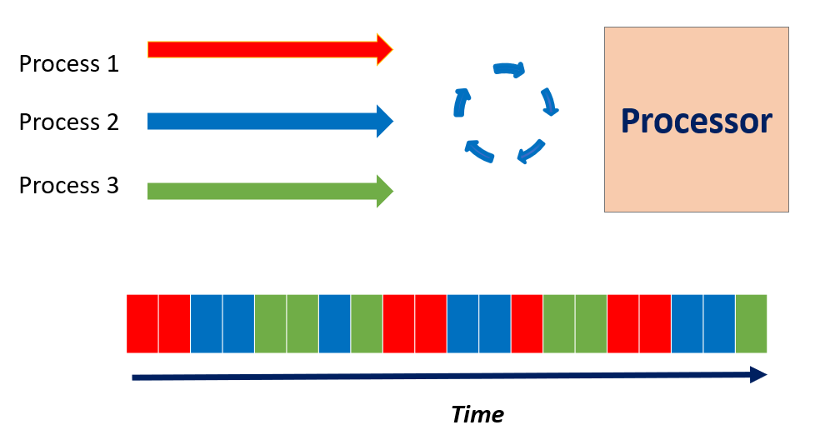
Many Processes, One Processor (CPU)

Slide 168
Process Management
Creating and deleting both user and system processes
Suspending and resuming processes
Process synchronization
Process communication
Deadlock handling

Slide 169
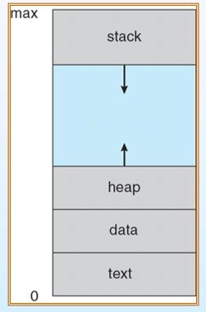
Process in Memory
A process includes:
program counter
stack
data section

Slide 170
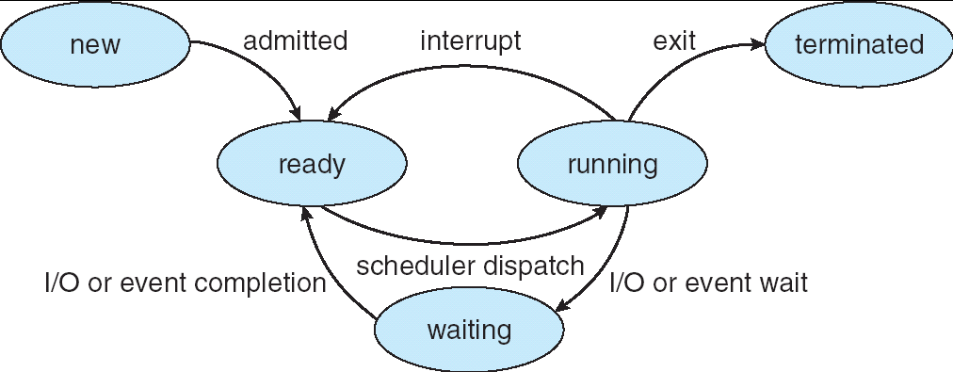
Process States
new: The process is being created
running: Instructions are being executed
waiting: The process is waiting for some event to occur
ready: The process is waiting to be assigned to a processor
terminated: The process has finished execution

Slide 171
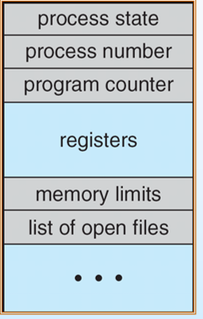
Process Control Block (PCB)

Slide 172
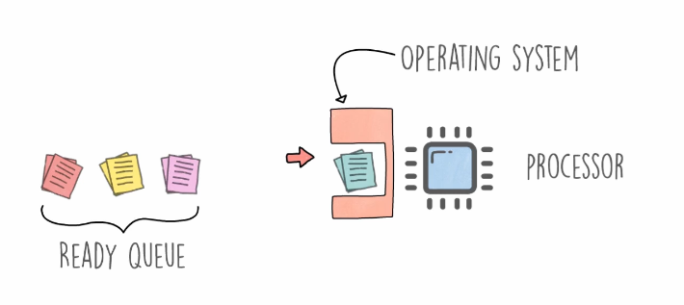
Process Scheduling
Process scheduling Remove the running process from the CPU and select another process on the basis of a particular strategy
Process scheduling is an essential part of a Multiprogramming operating system
More than one process can be loaded into the main memory at a time and loaded processes share the CPU one after the other using time multiplexing

Slide 173
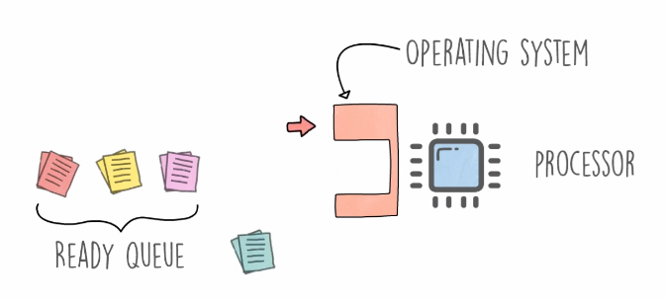
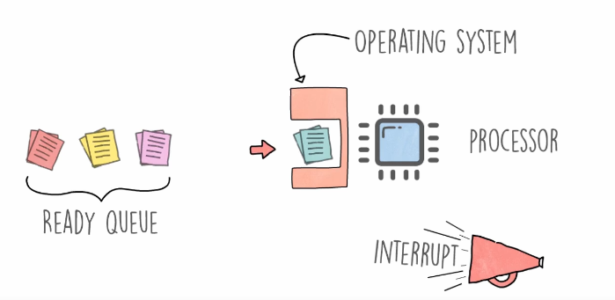
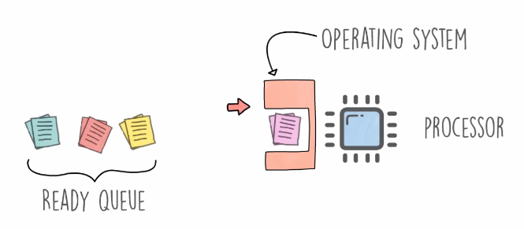
Process Scheduling
A process is running
An interrupt occurs (either in the running process, or the OS interrupts)
The operating systems moves the running process to the ready queue
The next ready process starts running

Slide 174
Scheduling Queues
Scheduling queues = Queues of processes or devices
When a process enters into the system, then this process is put into a scheduling queue (also called as job queue)
This queue consists of all processes in the system

Slide 175
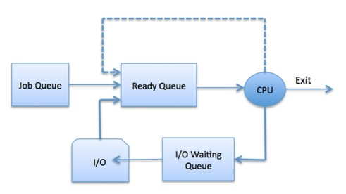
Process Scheduling

Slide 176
Scheduling Queues
A newly arrived process is put in the ready queue, waiting for the CPU
A running process could:
Issue an I/O request and then it would be placed in an I/O queue
Create new sub process and will wait for its termination
Be removed forcibly from the CPU, as a result of interrupt and put back in the ready queue

Slide 177
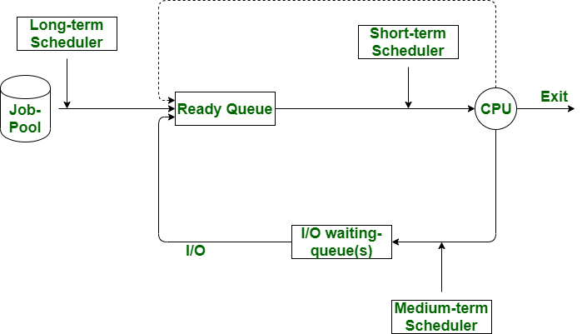
Scheduler Types
Scheduler: System software which handles process scheduling
Three types
Long Term Scheduler
Short Term Scheduler
Medium Term Scheduler

Slide 178
Long Term Scheduler
Long term scheduler: Job scheduler
Selects processes from the queue and loads them into memory for execution
Then they wait for CPU
Provides a balanced mix of jobs: I/O bound and processor bound
Controls the degree of multiprogramming (Number of new processes and departing processes)

Slide 179
Short Term Scheduler
Short term scheduler: CPU scheduler
Moves a ready process to the running state
Selects a process among the processes that are ready to execute and allocates CPU to one of them
Also known as dispatcher
Executes most frequently

Slide 180
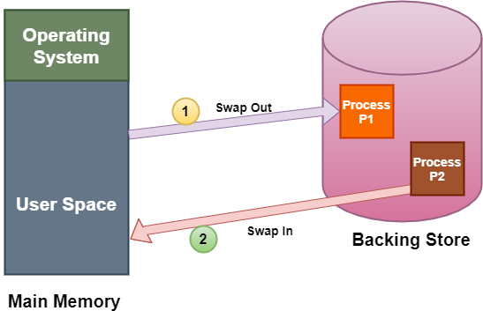
Medium Term Scheduler
Medium term scheduler: Performs swapping
A running process may become suspended if it makes an I/O request
Swapping: The medium tern scheduler moves the suspended process to the secondary storage

Slide 181
CPU Scheduling (i.e. Short Term Scheduling)
Resources: the things operated on by processes (CPU time, Disk space)
Resources can be:
Preemptive: OS can take resource away, use it for something else, and then give it back later (e.g. processor)
Non-preemptive: Once given, it cannot be reused until the process gives it back (e.g. file, terminal)
Anything is preemptive if it can be saved and restored

Slide 182
Criteria for a Good CPU Scheduling Algorithm
Fairness: Every process gets its fair share of CPU (i.e. time slice)
Efficiency (utilization): Keep CPU busy
Response time: Minimize response time for interactive users
Throughput: Maximize jobs per hour
Minimize overhead (Context switch)

Slide 183
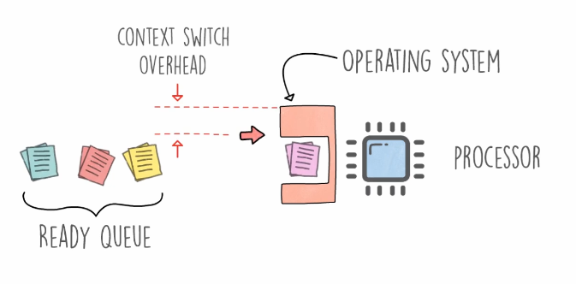
Context Switch

Slide 184
Process Timings
Arrival time: Time when the process arrived in the process queue
Burst time: The CPU time used by the process
Completion time: The time at which the process got completed
Turn around time: The time at which the process got completed minus the time at which the process entered the system
Waiting time: The time for which the process needed to wait, due to lack of CPU attention
Turn Around Time = Completion Time - Arrival Time
Waiting Time = Turnaround time - Burst Time OR Start of Last Burst Time – Time Spent in Bursts – Arrival Time

Slide 185
Important Point about Waiting Time
When using the second formula …
The calculation of waiting time will depend on whether or not we are given arrival time of the process
Two cases:
Arrival time not given: Waiting time = Start of last burst – Time spent in earlier bursts
Arrival time given: Waiting time = Start of last burst – Time spent in earlier bursts – Arrival time
Examples will clarify

Slide 186
Scheduling Algorithms
First-Come First-Served (FCFS)
Round Robin (RR)
Priority
Shortest Job First (SJF)
Preemptive algorithm: Can be interrupted by an operating system
Non-preemptive algorithm: Cannot be interrupted by an operating system even if there is a need to do so

Slide 187
First Come First Serve (FCFS)
First Come First Serve (FCFS): Also called First In First Out (FIFO)
Simplest: Executes the process that comes first
Non-preemptive
The arrival time of processes is deciding factor here
Easiest to implement

Slide 188
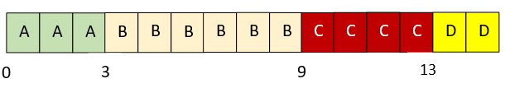
Example
Consider the following processes and draw a chart showing the FCFS execution
Process | Arrival Time | Processing Time
A | 0.000 | 3
B | 1.001 | 6
C | 4.001 | 4
D | 6.001 | 2

Slide 189
Example
Consider the following processes and calculate average turnaround time and waiting time in FCFS
Turnaround time = Terminated time – Arrival time
= ( (3-0) + (9-1) + (13-4) + (15-6) ) / 4 = 7.25
Waiting time = Start of last burst – Time spent in earlier bursts – Arrival time
A: 3 - 3 = 0 B: 3 - 1 = 2 C: 9 -4 = 5 D: 13 – 6 = 7
Process | Arrival Time | Processing Time
A | 0.000 | 3
B | 1.001 | 6
C | 4.001 | 4
D | 6.001 | 2

Slide 190
Round Robin (RR)
Round Robin (RR): Preemptive scheduling algorithm
Uses concept of time slice
Process at the beginning of ready queue gets chance to be executed first, but only for span of one time slice
Next process gets the chance, again for span of one time slice
Designed for time-sharing systems

Slide 191
Round Robin (RR) – Key Points
If Process burst < Time slice, then as soon as it is over, the CPU resources are released voluntarily
Example: time slice = 4 ms, Burst time = 2 ms
The next process in the ready queue occupies the CPU after 2 ms
If Process burst > Time slice, the timer will go off and the process is preempted
Example: time slice = 4 ms, Burst time = 8 ms
The next process in the ready queue takes over after 4 ms

Slide 192
Round Robin (RR) Example
Consider 4 processes where time slice is 3
Calculate average waiting time
Process | Burst time
P1 | 10
P2 | 2
P3 | 5
P4 | 6

Slide 193
Explanation
Process | Burst time
P1 | 10
P2 | 2
P3 | 5
P4 | 6
P1 is executed for 3ms. Then P2 is executed. As, P2 is only 2ms long, after 2ms, the next process occupies the CPU.
P3 then is executed for 3ms. So, P3 still needs 2ms. Then, P4 is executed for 3ms. P4 still needs 3ms.
P1 is again executed for 3ms. P1 still needs 4ms.
P3 is executed for 2ms. Then, P4 is executed for 3ms.
Now remaining process is P1 only. It executes for 3ms. After that, Since P2, P3 and P4 are already finished, P1 is executed again for remaining time (1ms).
Time slice = 3

Slide 194
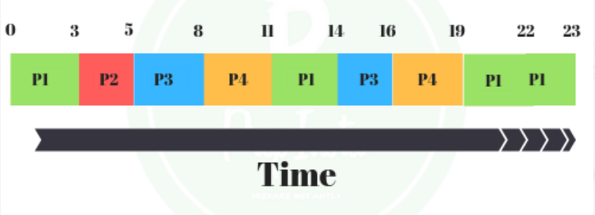
Solution
P1 has utilized two 3ms time slices earlier, so we subtract 3 twice from its last start time
Here, we are not given process arrival times, so Waiting time = Start of last burst – Time spent in earlier bursts
Waiting time for P1 = 19-(3+3) = 13ms
Waiting time for P2 = 3ms
Waiting time for P3 = 14-3 = 11ms
Waiting time for P4 = 16-3 = 13ms
Total average waiting time = (13+3+11+13)/4 = 10ms
Both P3 and P4 have utilized one time slice each, earlier, so we subtract 3 from them

Slide 195
Exercise
Consider the following processes and using RR (time slice = 2), draw the execution chart and calculate average turnaround time and average waiting time
Process | Arrival Time | Processing Time
A | 0.000 | 3
B | 1.001 | 6
C | 4.001 | 4
D | 6.001 | 2

Slide 196
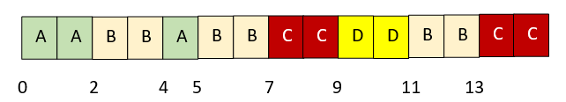
Solution
Process | Arrival Time | Processing Time
A | 0.000 | 3
B | 1.001 | 6
C | 4.001 | 4
D | 6.001 | 2
Here, we are given process arrival times, so Waiting time = Start of last burst – Time spent in earlier bursts – Arrival time
Explanation: When process A’s first time slice expires, process B runs. At time4, process A is restarted and process B returns to ready queue. At time 4.001, process C enters the ready queue after process B. At time 5, process A terminates and process B runs. At time 6.001, process D enters the ready queue behind process C. At time 7, process C, D, B, and C run in sequence.
Average turnaround time = Terminated time – Arrival time
( (5-0) + (13-1) + (15-4) + (11-6) ) / 4 = 8.25
Waiting time = Last burst start – Time spent in earlier bursts – Arrival time
A: 4 – 2 - 0 = 2 B: 11 – 4 – 1 = 6 C: 13 – 2 – 4 = 7 D: 9 – 6 = 3

Slide 197
Round Robin – Summary
Advantage:
Does not cause starvation, as all the processes get equal CPU time slices
Disadvantages:
Has an overhead of context switching
Too small time slices may cause overhead and slower execution of processes

Slide 198
Priority Scheduling
Priority scheduling: Non-preemptive algorithm
Designed for batch systems
The process priorities are compared and processes are scheduled accordingly
Important: Read the question carefully: Priority 0 = Highest or Lowest?

Slide 199
Example
For the processes listed below, draw a chart showing their execution using priority scheduling. A larger number has higher priority. Consider (a) Preemptive and (b) Non-preemptive cases separately. Consider higher priority number = higher priority.
Process | Arrival time | Burst time | Priority
A | 0.000 | 4 | 3
B | 1.001 | 3 | 4
C | 2.001 | 3 | 6
D | 3.001 | 5 | 5

Slide 200
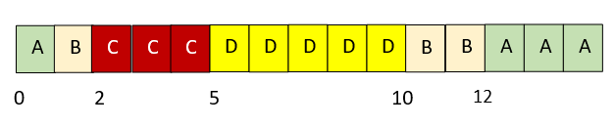
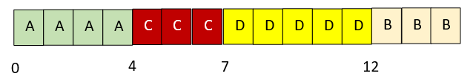
Solution
Preemptive case
Non-preemptive case
Process A runs until process B arrives. Process B preempts process A and runs until it is preempted by process C. After process C terminates, process D runs. After process D, the lower-priority process B and process A run.
Process A runs to completion. When it terminates, the other three processes are all waiting to run. They run in the order of their priority: C, D, and B.

Slide 201
Problem
For the same processes, calculate turnaround time for each process using priority scheduling
Preemptive
A: 15 – 0 = 15 B: 12 – 1 = 11 C: 5 – 2 =3 D: 10 – 3 = 7, Avg = (15 + 11 + 3 + 7) / 4 = 9
Non-preemptive
A: 4 – 0 = 4 B: 15 – 1 = 14 C: 7 – 2 = 5 D: 12 – 3 = 9, Avg = (4 + 14 + 5 + 9) / 4 = 8
Process | Arrival time | Burst time | Priority
A | 0.000 | 4 | 3
B | 1.001 | 3 | 4
C | 2.001 | 3 | 6
D | 3.001 | 5 | 5

Slide 202
Priority Scheduling – Points
A process having lower priority can be indefinitely blocked or starved
To prevent this, we do aging, where the priority of the process is increased as it waits in the queue
So, a process which has been in a queue for a long time will reach high priority, and hence it will not be starved

Slide 203
Shortest Job First (SJF)
Shorted Job First (SJF): Non pre-emptive algorithm
Selects the process with the shortest expected processing time
If there is a tie, FCFS is used
Favors short processes over longer ones
Can lead to starvation for a long process in extreme cases

Slide 204
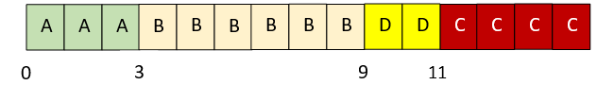
Example
Consider the following processes and draw a chart showing the SJF execution
Process | Arrival Time | Processing Time
A | 0.000 | 3
B | 1.001 | 6
C | 4.001 | 4
D | 6.001 | 2
Explanation: A starts executing; it is the only choice at time 0. At time 3, B is the only process in the queue. At time 9, when B completes, process D runs because it is shorter than process C.

Slide 205
Example
Consider the following processes and calculate average turnaround time and waiting time for each process using the SJF algorithm
Turnaround time: ((3 – 0) + (9 – 1) + (15 – 4) + (11 – 6) / 4) = 6.75
Waiting time: A: (3 – 3 - 0) = 0; B: (3 – 0 - 1) = 2; C: (11 – 0 - 4) = 7; D: (9 – 0 - 6) = 3
Process | Arrival Time | Processing Time
A | 0.000 | 3
B | 1.001 | 6
C | 4.001 | 4
D | 6.001 | 2

Slide 206
Linux Processes
Process types: Parent, Child, Daemon, Zombie (Defunct), Orphan
Try command: ps -ef | less … e = All processes, f = Full-format
Note that the first process is init with pid 1
Zombie: A terminated process whose data has not been released
Orphan: A child process whose parent process has terminated before it is terminated (e.g. while ls is running, we close the terminal)
Daemon: Long-running, independent processes such as sshd, httpd, etc
fork() system call
Parent process
Child process
fork() system call
ls command
bash
Directory listing

Slide 207
Foreground and Background Processes
By default, all the processes are foreground processes
When a process runs in the foreground, no other process can run in the terminal until the process is terminated or killed
When we add an ampersand (&) to a foreground command, it is run as a background process
When a process runs in the background, another process can run in the foreground

Slide 208
Example
atul@lubuntu:~$ sleep 10
atul@lubuntu:~$ sleep 60 &
[1] 1150
atul@lubuntu:~$ echo "hello there"
hello there
atul@lubuntu:~$ jobs
[1]+ Running sleep 60 &
atul@lubuntu:~$ fg
sleep 60
What are we doing?
Start a process in the foreground
Then start a process in the background
Then run another process in the foreground
Check that the background process is still running
Finally, bring the background process to the foreground

Slide 209
Linux Process Management Commands
ps … Process status
PID TTY TIME CMD
1524 pts/0 00:00:00 bash
1907 pts/0 00:00:00 ps
ps -ef … all processes, full output
UID PID PPID C STIME TTY TIME CMD
root 1 0 0 15:12 ? 00:00:02 /sbin/init splash
root 2 0 0 15:12 ? 00:00:00 [kthreadd]

Slide 210
Linux Process Management Commands
Finding all processes started by a user
ps -u atul
Display a tree-like representation of processes
pstree
pstree -p 1234 … for a particular process
Dynamically changing information
top … q to quit

Slide 211
Signals and Killing Processes
Kill a process: the kill command
sudo kill <pid>
sudo kill 1947
[sudo] password for atul:
kill -l … List all the signals related to the kill command
Signal: Asynchronous message sent to a process

Slide 212
Signals and Kill Example
From the Ubuntu start button -> Accessories -> Kcalc
Come back to the terminal: pgrep -l kcalc … process grep
It will show the PID for the kcalc program … say 1208
Then kill -2 1208 … Send the SIGINT signal (2) to PID 1208
It will kill the calculator program
SIGNIT = Interrupt, same as Ctrl+C

Slide 213
Signals and Kill Example – Different Syntax
Now start Firefox
Come back to the terminal: pidof firefox … Even simpler
It will show the PIDs for firrfox … say 2028 2015 1996 …
Then kill -INT 2028 2015 1996 …
Same result
Even shorter: kill –SIGNIT $(pidof firefox)

Slide 214
Memory Management

Slide 215
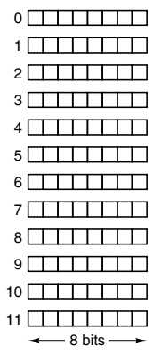
Memory
Memory: Place where programs and data are stored, also called Random Access Memory (RAM) or Primary Memory
Made up of cells
Each cell has an address
n cells: Addresses are 0 to n − 1
All cells in a memory contain the same number of bits

Slide 216
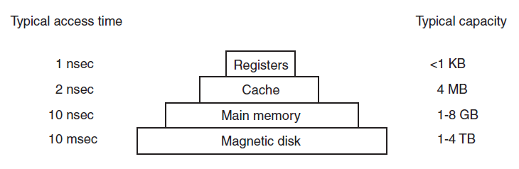
Memory Hierarchy
Fastest access, Most expensive
Slowest access, Least costly

Slide 217
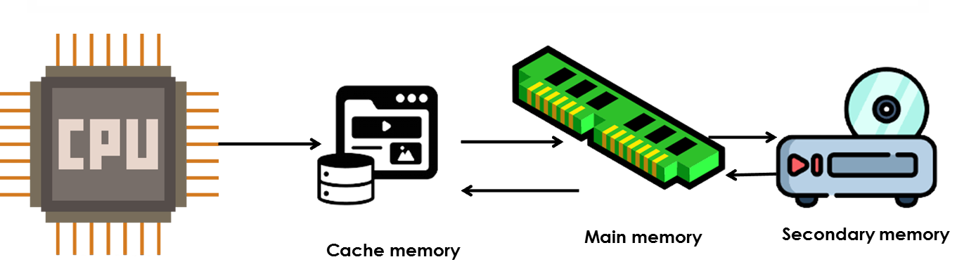
Cache Memory Placement

Slide 218
Memory Types
Random Access Memory (RAM): Read/Write possible
Static RAM (SRAM)
Dynamic RAM (DRAM)
Read Only Memory (ROM): Only Read possible
Useful for booting up, fixed data (e.g. electronic devices)

Slide 219
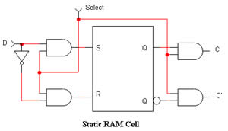
Static RAM (SRAM)
Static RAM (SRAM): Made of flip-flops, Needs external power to retain contents
Very fast, Access time: < ns
Cache memory is made from it

Slide 220
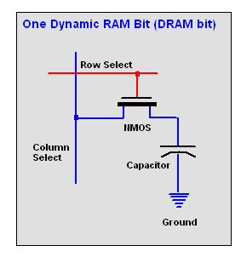
Dynamic RAM (DRAM)
Dynamic RAM (DRAM): Made from transistor and capacitor
Needs constant refreshing
High capacity, so used to create main memory
Slow (access time of tens of nanoseconds)

Slide 221
Read Only Memory (ROM)
Read Only Memory (ROM): The data are inserted during manufacture
Contents cannot be modified
Much cheaper than RAM
Inflexible, because its contents cannot be changed after manufacture

Slide 222
Machine Language Instructions in a Process
Example of Process P1:
Address 0: 0011 0000 0000 0000
Address 1: 0010 0010 0000 0110
Address 2: 0110 0100 0100 0000
Address 3: 0000 0100 0000 0101
Address 4: 0001 0010 0110 0001
Address 5: 0000 1110 0000 0001
Address 6: 1111 0000 0010 0101
Example of Process P2:
Address 0: 1111 0000 0010 0101
Address 1: 1110 0010 0001 1110
Address 2: 1100 0101 0100 1100
Address 3: 1100 1000 0010 0001
Address 4: 0001 0010 0110 0001

Slide 223
Process Addresses and Memory Addresses
Memory address | Contents
0 | …
1 | …
2
3
4
5
6
7
8
9
10
11
12
13
14
15
16 | …
Memory has cells, numbered using addresses
Example:

Slide 224
Accommodating Multiple Processes in Memory
Memory address | Contents
0 | 0011 0000 0000 0000
1 | 0010 0010 0000 0110
2 | 0110 0100 0100 0000
3 | 0000 0100 0000 0101
4 | 0001 0010 0110 0001
5 | 0000 1110 0000 0001
6 | 1111 0000 0010 0101
7
8 | 1111 0000 0010 0101
9 | 1110 0010 0001 1110
10 | 1100 1000 0010 0001
11 | 0001 0010 0110 0001
12 | 0001 0010 0110 0001
13
14
15
16 | …
Process P1’s addresses and real memory’ addresses map one-to-one
But Process P2’s addresses 0 to 4 are mapped to real memory addresses 8 to 12
Process P1
Process P2

Slide 225
Relocation
Note that both processes have their own address space starting from 0 to some number
Physical memory (RAM)
Address space: Addresses of the process, so logical addresses
Dynamic relocation maps the address space of each process onto a different part of physical memory (i.e. RAM)
Process P2
Address space: 0 to 1000
Address 6000
Address 5000
Process P1
Address space: 0 to 3500
Address 4000
Address 3000
Address 2000
Address 1000
But the real physical addresses are different
Address 0

Slide 226
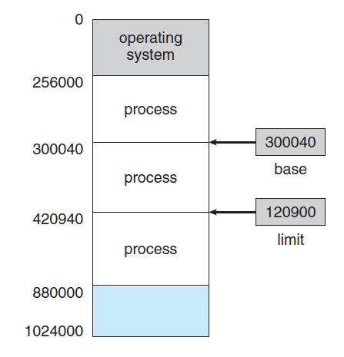
Memory and Protection
Base register: 300040 (Defines the start)
Limit register: 120900 (Defines the end)
Program can legally access all addresses from 300040 to 420939

Slide 227
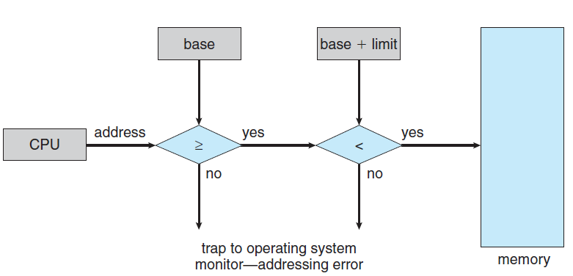
Trap
Trap: A process tries to access OS memory or memory of another process
Fatal error

Slide 228
Contiguous and Dynamic Memory Allocation

Slide 229
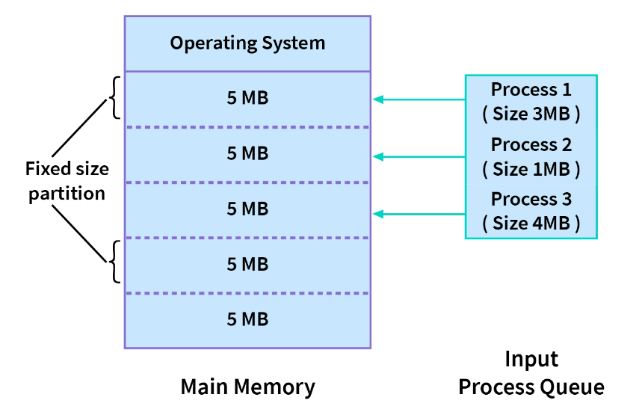
Contiguous Memory Allocation
Each process is allocated a single section of memory in a contiguous manner
Types: Fixed-size partitions (diagram) or Variable-size partitions (different sized partitions)

Slide 230
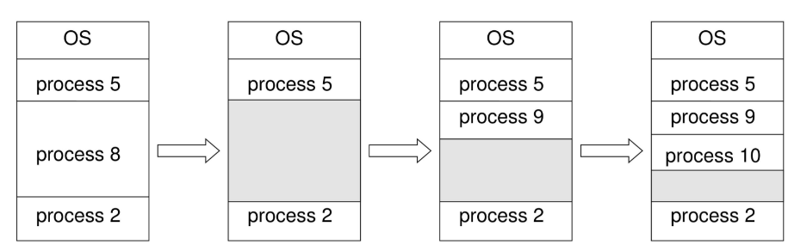
Dynamic Memory Allocation
Memory is not allocated contiguously to the incoming processes
Approaches:
First fit. Allocate the first big enough free block
Best fit. Allocate the smallest free block that is large enough
Worst fit. Allocate the largest free block
Process 8 goes out, 9 and 10 come in

Slide 231
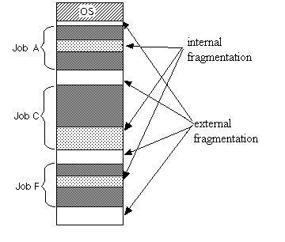
Fragmentation
External fragmentation: Wasted memory between partitions
Internal fragmentation: Wasted memory inside a partition
Solution?
None to internal fragmentation

Slide 232
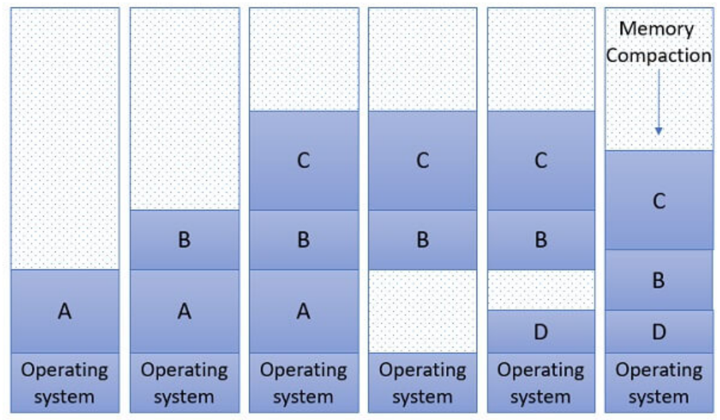
Compaction
Compaction: Reduce external fragmentation
Aim: Shuffle memory contents to place all free memory together in one large block
Not always possible

Slide 233
Segmentation

Slide 234
Segmentation
When a compiler compiles a program, divides it into smaller parts
How to ensure these parts do not clash with each other?
Solution: Segmentation
Code Segment
Data Segment
Stack Segment

Slide 235
Segmentation
Main memory: Collection of segments
Logical address: Segment number and offset
Segment is a logical entity
Different segments can have different lengths
Different segments can grow or shrink without affecting other segments

Slide 236
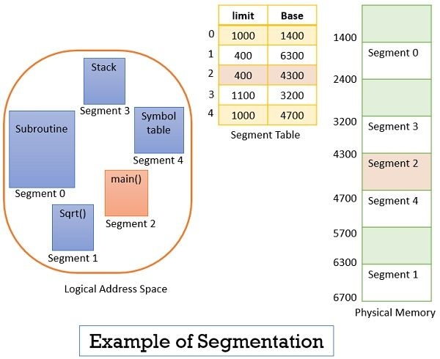
Segmentation Example
Suppose CPU needs to read the 53rd byte in segment number 2
Limit register for segment 2 contains 400
Since 53 < 400, access is legal
Any byte = Base register + Offset number
= 4300 + 53 = Byte at physical memory location 4353

Slide 237
Segmentation: C++ Program
#include <iostream>
// Global variable
const char* globalMessage = "Welcome to C++";
// Function declaration for calculating sum
int calculateSum(int num1, int num2);
int main() {
int num1, num2;
// Print the global message
std::cout << "Global Message: " << globalMessage << std::endl;
// Prompt the user to enter the first integer
std::cout << "Enter the first integer: ";
std::cin >> num1;
// Prompt the user to enter the second integer
std::cout << "Enter the second integer: ";
std::cin >> num2;
// Calculate the sum using the calculateSum function
int sum = calculateSum(num1, num2);
// Display the sum
std::cout << "The sum of " << num1 << " and " << num2 << " is " << sum << std::endl;
return 0;
}
// Function definition for calculating sum
int calculateSum(int num1, int num2) {
return num1 + num2;
}

Slide 238
Segmentation: C++ Program
Code Segment (CS): Contains the executable instructions of the program, including the main() function and the calculateSum() function
Data Segment (DS): globalMessage is a pointer to a string "Welcome to C++“, which is stored in the data segment
Stack Segment (SS): The stack segment is used for managing function calls and local variables
More on stack
Local variables num1, num2, and sum are allocated on the stack within the main() function
When calculateSum() is called from main(), space for its parameters and local variables (none in this case) will also be allocated on the stack
As function calls are made and returned, the stack grows and shrinks accordingly to manage the function call hierarchy and local variables

Slide 239
Working of the Stack Segment
Main Function Entry: When the program starts, the main() function is called, whose entry point is pushed onto the stack, along with space for local variables and function call information
Global Variable Printing: Inside main(), the address of the string "Welcome to C++" is pushed onto the stack, followed by instructions to print the string and after printing, this portion of the stack is cleared as it's no longer needed
User Input: Next, the program prompts the user to enter two integers (num1 and num2) - The space for these two integers is allocated on the stack

Slide 240
Working of the Stack Segment
Sum Calculation: After obtaining user input, the calculateSum() function is called from main() to compute the sum of num1 and num2 - When calculateSum() is called, the return address of main() is pushed onto the stack, along with space for parameters and local variables of calculateSum() – Here, none
Sum Return: After calculateSum() completes its computation, it returns the sum - The return value is stored in a specific location determined by the calling convention (often a CPU register) - The stack space allocated for calculateSum() is then cleared as the function returns

Slide 241
Working of the Stack Segment
Back in main(), the sum obtained from calculateSum() is displayed to the user - This involves pushing the sum onto the stack, followed by instructions to print it - After printing, this portion of the stack is cleared
Function Exit: Finally, as main() exits, any remaining stack space allocated for main() is cleared, and the program terminates

Slide 242
Virtual Memory and Paging

Slide 243

Understanding Virtual Memory
Imagine that the DAC classroom can accommodate only 100 students at a time (Physical memory only has 100 addresses)
However, admission is given to 450 students (The running process needs 500 memory addresses)
Solution: Divide the students into 5 batches (Divide process memory needs into smaller parts)

Slide 244
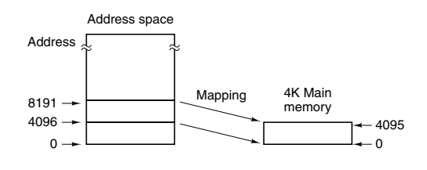
Real-life Example
Physical memory (RAM) size = 4096 bytes
Process needs ~1 MB
Solution: Bring only 4096 bytes of addressable memory (process data) into the physical memory at a time and keep the rest in secondary storage
Example:
0 to 4,095 OR
4,096 to 8,191 OR
8,192 to 12,287
etc
Addressable memory
Real/physical memory (RAM)

Slide 245
Terminology
Process memory: Locations 0 to ~1 MB: Virtual address space
Real physical memory/RAM: Locations 0 to 4095 (Physical address space)
Page table or Page map table: Maps virtual address to physical address
Result: Virtual memory

Slide 246
Virtual Memory: Modernization
Now, physical memory is much more than 4096 bytes (e.g. 8/16 GB)
It is logically divided into page frames
Example: One page frame = 1 MB
So, number of page frames = 16 GB / 1 MB = (16 * 1024) / 1 = 16,384
Process memory is divided into virtual pages
Some virtual pages are loaded into page frames, and the remaining ones are in the secondary memory
See next slide

Slide 247

Page Mapping Table or Page Table
Virtual memory
Physical memory

Slide 248
Page Replacement – Basic idea
Page fault: Program refers to a virtual memory address that is not present in the physical/real main memory
Working set: Set of pages that a program is actively and heavily using
Page replacement policy: Decides how to handle page faults
Least Recently Used (LRU): Evicts the page least recently used
First In First Out (FIFO): Removes the first loaded page
Thrashing: A program that generates page faults frequently
Demand paging: Load pages only on demand, not in advance
Dirty bit: Tells the OS if the page contents were modified, so as to not lose the changes in the event of page replacement

Slide 249
Shared Pages
Multiprogramming environment: Several users may run the same program at the same time
Solution: Separate pages into code and data
Shared pages: Share code pages, do not share data pages
Re-entrant code = Read-only code
For code to be re-entrant, it must not contain any data that can be modified by a process

Slide 250
Throttling
Throttling: Operating system intentionally limits or controls certain resources or processes to prevent excessive consumption
Examples: CPU usage, memory usage, network bandwidth, and other system resource

Slide 251
Deadlocks

Slide 252








Understanding Deadlocks
Alice reserves book and wants T-shirt also
Bob reserves T-shirt and wants book also

Slide 253



Deadlock
Thread 1 -> Lock 1 -> R1
Thread 2 -> Lock 2 -> R2
Thread 2 -> Wants to Lock -> R2
Thread 2 -> Wants to Lock -> R1
Result: Deadlock

Slide 254
Four Simultaneous Necessary Conditions for a Deadlock
Mutual exclusion. Only one process can use a resource
Hold and wait. A process must be holding at least one resource and waiting to acquire additional resources that are currently being held by other processes
No preemption. Resources cannot be preempted; that is, a resource can be released only voluntarily by the process holding it
Circular wait. P1->R1 and needs R2, P2->R2 and needs R3, P3->R3 and needs R4, P4->R4 and needs R1 (See next slide)

Slide 255

Circular Wait

Slide 256
Deadlock Prevention and Avoidance
Deadlock prevention: Never allow all the four deadlock conditions to become true
Deadlock avoidance: Allocate resources to only one process at a time

Slide 257
Deadlock Prevention
Condition 1: Mutual exclusion: Only one process can use a resource at a time
Solution: Make all the resources sharable (e.g. only use read-only files)
Practically possible? No

Slide 258
Deadlock Prevention
Condition 2: Hold and wait: A process holds a resource and needs another resource held by another process
Solution: Ensure that whenever a process requests a resource, it does not hold any other resources
Approach 1: Each process must be allocated all its resources before it begins execution
Approach 2: Allow a process to request resources only when it has none
Practical problems
Resource utilization may be low, since resources may be allocated but unused for a long period
Starvation is possible: A process that needs many resources may have to wait indefinitely, because at least one of the resources that it needs is always allocated to some other process

Slide 259
Deadlock Prevention
Condition 3: No pre-emption: Resources cannot be taken away from processes
Solution: If a process is holding some resources and requests another resource that cannot be immediately allocated to it, then all resources the process is currently holding are preempted
Result: The process will be restarted only when it can regain its old resources, as well as the new ones that it is requesting
Limitation: Only applicable to resources whose state can be easily saved and restored later, such as CPU registers and memory space

Slide 260
Deadlock Prevention
Condition 4: Circular wait: P1->R1, Needs R2; P2->R2, Needs R3, etc
Solution: Number resources and mandate an increasing order when processes ask for them
Example: Tape drive = 1, Disk drive = 5, Printer = 12
Now a process that needs the tape drive and the printer at the same time must first request the tape drive and then the printer

Slide 261
Deadlock Avoidance
Ask for additional information about how resources are to be requested
Example: We must know that process P will request first the tape drive and then the printer before releasing both resources, whereas process Q will request first the printer and then the tape drive
Now we know whether a deadlock is possible or not

Slide 262
Process Synchronization

Slide 263
Process Synchronization
Multiple processes/threads share access to resources such as memory, files, devices
This may cause unpredictable behavior
Solution: Synchronize their activities
Problem Example: Initial bank balance: $100
Process P1: Reads balance and withdraws $50, so new balance = $50
Process P2: At the same time, reads balance and deposits $30, so new balance = $130
Problem! Balance should have been $100 - $ 50 + $30 = $80, but it is now $130 … called as race condition (Both processes are racing to reach their respective outcomes, causing problems)

Slide 264
Semaphore
Semaphore: A variable used to control access to a common resource
Keeps a count of resource usage and decides if the resource can be made available to a requesting process
Two types
Counting semaphore: Can be any number
Binary semaphore: Semaphore with a value of 0 or 1 only
The Producer-Consumer Problem can be solved using semaphores
Threads and processes perform wait() and signal() operations to indicate whether they are acquiring or releasing resources

Slide 265
Semaphore Solution
Consider a book library that has 10 copies of a particular book, which people borrow/return
available_copies = Semaphore(10)
# Borrow a copy of the book
def borrow_book():
if (available_copies > 0)
available_copies.wait()
print("A member has borrowed a copy of the book.")
# Return a copy of the book
def return_book():
available_copies.signal()
print("A member has returned a copy of the book.")
wait():
while (available_copies == 0):
pass # Endless loop
available copies--
signal():
available copies++

Slide 266
SemaphoreExample.java
import java.util.concurrent.Semaphore;
import java.util.Random;
class Library {
private int availableCopies;
private final Semaphore semaphore;
private final Object monitor = new Object(); // Monitor object for synchronization
public Library(int initialCopies) {
this.availableCopies = initialCopies;
this.semaphore = new Semaphore(initialCopies);
}
public void borrowBook(int borrowerId) throws InterruptedException {
semaphore.acquire();
synchronized (monitor) { // Synchronize on monitor object
System.out.println("Borrower " + borrowerId + " borrowed a book.");
System.out.println("Available copies: " + semaphore.availablePermits());
}
double borrowTime = new Random().nextDouble() * (2.0 - 0.5) + 0.5; // Random borrow time between 0.5 and 2.0 seconds
Thread.sleep((long)(borrowTime * 1000)); // Convert seconds to milliseconds
}
public void returnBook(int borrowerId) {
synchronized (monitor) { // Synchronize on monitor object
System.out.println("Borrower " + borrowerId + " returned a book.");
semaphore.release();
System.out.println("Available copies: " + semaphore.availablePermits());
}
}
}
class BorrowerThread extends Thread {
private final Library library;
private final int borrowerId;
public BorrowerThread(Library library, int borrowerId) {
this.library = library;
this.borrowerId = borrowerId;
}
@Override
public void run() {
try {
library.borrowBook(borrowerId);
// Ensure that borrowBook is called more often than returnBook
if (borrowerId % 2 == 0) {
library.returnBook(borrowerId);
} else {
// Sleep for a short period to simulate borrowing time
Thread.sleep(1000);
library.returnBook(borrowerId);
}
} catch (InterruptedException e) {
e.printStackTrace();
}
}
}
public class SemaphoreExample {
public static void main(String[] args) throws InterruptedException {
Library library = new Library(10); // 10 initial copies
BorrowerThread[] borrowerThreads = new BorrowerThread[15]; // 20 borrower threads
for (int i = 0; i < borrowerThreads.length; i++) {
System.out.println("Thread " + i + " starting");
borrowerThreads[i] = new BorrowerThread(library, i + 1);
borrowerThreads[i].start();
}
for (BorrowerThread thread : borrowerThreads) {
thread.join();
}
}
}

Slide 267
Mutual Exclusion (Mutex)
Mutual Exclusion (Mutex): An object that allows multiple program threads to share the same resource, such as a file, but not simultaneously
Different from semaphores
Semaphore = Signaling mechanism, Mutex = Locking mechanism
Semaphore: May or may not be binary, Mutex: Always binary
Example follows …

Slide 268
Mutual Exclusion Solution
# Withdrawal Process
def withdraw(amount):
balance_mutex.lock()
current_balance = get_current_balance()
new_balance = current_balance - amount
update_balance(new_balance)
balance_mutex.unlock()
# Deposit Process
def deposit(amount):
balance_mutex.lock()
current_balance = get_current_balance()
new_balance = current_balance + amount
update_balance(new_balance)
balance_mutex.unlock()

Slide 269
Mutual Exclusion: Python
import threading
import random
class BankAccount:
def __init__(self):
self.balance = 0
self.lock = threading.Lock()
def deposit(self, amount):
with self.lock:
print(f"Depositing {amount}...")
self.balance += amount
print(f"New balance: {self.balance}")
def withdraw(self, amount):
with self.lock:
if self.balance >= amount:
print(f"Withdrawing {amount}...")
self.balance -= amount
print(f"New balance: {self.balance}")
else:
print("Insufficient funds!")
# Function to simulate transactions
def simulate_transactions(account, transaction_type, num_transactions):
for _ in range(num_transactions):
amount = random.randint(1, 100)
if transaction_type == 'deposit':
account.deposit(amount)
elif transaction_type == 'withdraw':
account.withdraw(amount)
# Create a bank account instance
account = BankAccount()
# Create and start deposit threads
deposit_threads = []
thread = threading.Thread(target=simulate_transactions, args=(account, 'deposit', 100))
deposit_threads.append(thread)
thread.start()
# Create and start withdraw threads
withdraw_threads = []
thread = threading.Thread(target=simulate_transactions, args=(account, 'withdraw', 100))
withdraw_threads.append(thread)
thread.start()
# Wait for all deposit threads to complete
for thread in deposit_threads:
thread.join()
# Wait for all withdraw threads to complete
for thread in withdraw_threads:
thread.join()

Slide 270
Mutual Exclusion in Java
import java.util.Random;
class BankAccount {
private int balance;
private final Object lock = new Object();
public BankAccount() {
this.balance = 0;
}
public void deposit(int amount) {
synchronized (lock) {
System.out.println("Depositing " + amount + "...");
balance += amount;
System.out.println("New balance: " + balance);
}
}
public void withdraw(int amount) {
synchronized (lock) {
if (balance >= amount) {
System.out.println("Withdrawing " + amount + "...");
balance -= amount;
System.out.println("New balance: " + balance);
} else {
System.out.println("Insufficient funds!");
}
}
}
}
class TransactionSimulator implements Runnable {
private final BankAccount account;
private final String transactionType;
private final int numTransactions;
private final Random random;
public TransactionSimulator(BankAccount account, String transactionType, int numTransactions) {
this.account = account;
this.transactionType = transactionType;
this.numTransactions = numTransactions;
this.random = new Random();
}
@Override
public void run() {
for (int i = 0; i < numTransactions; i++) {
int amount = random.nextInt(100) + 1; // Random amount between 1 and 100
if ("deposit".equals(transactionType)) {
account.deposit(amount);
} else if ("withdraw".equals(transactionType)) {
account.withdraw(amount);
}
}
}
}
public class MutualExclusion {
public static void main(String[] args) throws InterruptedException {
// Create a bank account instance
BankAccount account = new BankAccount();
// Create and start deposit thread
Thread depositThread = new Thread(new TransactionSimulator(account, "deposit", 1000));
depositThread.start();
// Create and start withdraw thread
Thread withdrawThread = new Thread(new TransactionSimulator(account, "withdraw", 1000));
withdrawThread.start();
// Wait for both threads to complete
depositThread.join();
withdrawThread.join();
}
}

Slide 271
Producer-Consumer Problem
Producer-consumer problem: Also called bounded-buffer problem
Two processes share a common fixed-size buffer
The producer puts information in
The consumer takes it out
Problems:
Producer should not try to add data when the buffer is already full
Consumer should not try to remove data from an empty buffer
Solutions: Use semaphore, mutex, conditional variables

Slide 272
Producer-Consumer Problem Example
Consider a bakery where bread is produced and sold to customers
The bakery has a limited storage space for bread, represented by a shelf with a fixed capacity
Producer: Baker who bakes bread and places it on the shelf
Consumers: Customers who purchase and consume the bread
How to implement Producer-Consumer Algorithm?

Slide 273
Producer-Consumer Problem Example
Producer (Baker)
Produces bread at a certain rate and places it on the shelf
If the shelf is full, the baker waits
Once there is space available, the baker places the bread on the shelf
Consumer (Customer)
Customers arrive at the bakery to purchase bread
If the shelf is empty, customers wait
Once bread is available, customers consume the bread
Two Semaphores: (1) Number of available spaces on the shelf (i.e. buffer), (2) Number of breads available
Mutex: A mutex called shelf_mutex is a lock – the producer/any consumer must obtain this lock before accessing the shelf and release it after using the shelf

